Slide 1
Bronx Community Health Dashboard: Prostate Cancer Last Updated: 9/24/2019 See last slide for more information about this project.

Slide 2
For men, prostate cancer is the 3rd leading cause of disability among cancers
Diabetes mellitus, asthma, and depressive
disorders are included for comparison.
Disability-Adjusted Life Years (DALYs) are calculated by adding the Years of Life Lost due to premature mortality in the population and the Years Lost due to disability for people living with the health condition or its consequences.
Data source: Global Burden of Disease Project, 2017.
Notes:
UPDATED

Slide 3
Prostate cancer incidence

Slide 4
Prostate cancer rates increased in the Bronx through the early 2000s, but have recently declined
The FDA approved PSA as a screening test in 1994. The PSA test was initially used aggressively, but its use as a frontline screening tool has declined due to concerns regarding diagnosis of non-clinically relevant prostate cancers (e.g., cancers not likely to lead to death or serious disability).
Data source: New York State Cancer Registry, 1976-2016.
Notes:
UPDATED

Slide 5
In the Bronx, the prostate cancer rate is highest among 65-74 year olds
Data source: New York State Cancer Registry, 2012-2016.
Notes:
UPDATED

Slide 6
In the Bronx, the prostate cancer rate is highest among non-Hispanic black men
Data source: New York State Cancer Registry, 2012-2016.
Notes:
UPDATED

Slide 7
Among all race/ethnicity groups, prostate cancer rates have decreased in recent years
Data source: New York State Cancer Registry, 1992-2016.
Rates are age-adjusted to the 2000 US Std million (19 age groups) standard.
Notes:
UPDATED

Slide 8
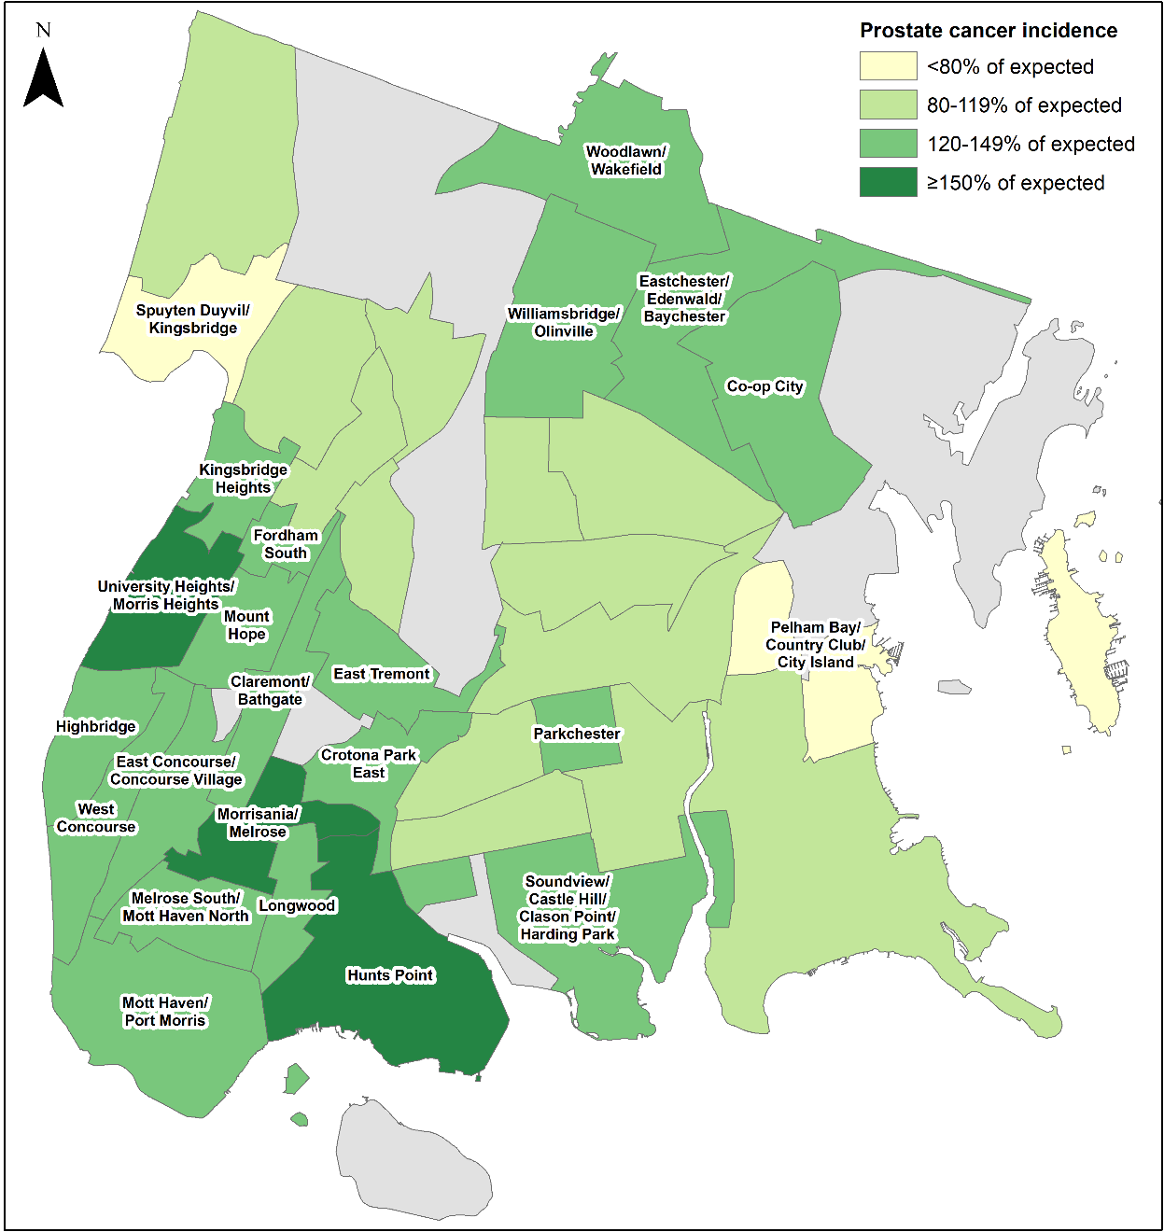
The incidence of prostate cancer is higher than expected in parts of the Bronx, mostly in the south and north east
Data source: NY State Cancer Registry, 2010-2014
Data is presented at the Neighborhood Tabulation Area (NTA)-level and is age- and sex-adjusted.

Slide 9
Mortality from prostate cancer

Slide 10
While prostate cancer rates have increased, mortality rates from prostate cancer have declined in the Bronx
Data source: New York State Cancer Registry, 1976-2016.
Notes:
UPDATED

Slide 11
In the Bronx, the mortality rate from prostate cancer is highest among 85+ year olds
Data source: New York State Cancer Registry, 2012-2016.
Notes:
UPDATED

Slide 12
In the Bronx, the mortality rate from prostate cancer is almost 2 times higher among non-Hispanic black men than Hispanic and non-Hispanic white men
Data source: New York State Cancer Registry, 2012-2016.
Notes:
UPDATED

Slide 13
In the Bronx, the mortality rate from prostate cancer has decreased across all race/ethnicity groups but remains highest among non-Hispanic black men
Data source: New York State Cancer Registry, 1992-2016.
Rates are age-adjusted to the 2000 US Std million (19 age groups) standard.
Notes:
AB done

Slide 14
Potential risk factors for which there is strong evidence of an association with advanced prostate cancer
High BMI/obesity
Data source: World Cancer Research Fund International—Diet, Nutrition, Physical Activity and Prostate Cancer 2018.
Notes:
Updated – no change

Slide 15
The prevalence of obesity among adults has stabilized in most boroughs while it continues to increase in the Bronx
A BMI of ≥30 is classified as obese
Data source: Community Health Survey, 2002-2017.
Body Mass Index (BMI) is calculated based on respondents’ self-reported weight and height.
Notes:
UPDATED

Slide 16
About the Community Health Dashboard Project
The goal of the project is to provide Bronx-specific data on risk factors and health outcomes with an emphasis on presenting data on trends, socio-demographic differences (e.g., by age, sex, race/ethnicity, etc.) and sub-county/neighborhood level data
Data will be periodically updated as new data becomes available.
Produced by Montefiore’s Office of Community & Population Health using publicly-available data sources
For more information please contact us at OCPHDept@montefiore.org

