Slide 1
Bronx Community Health Dashboard: Lung Cancer Last Updated: 9/24/2019 See last slide for more information about this project.

Slide 2
Lung cancer is the leading cause of disability among cancers in the US
Diabetes mellitus, asthma, and depressive
disorders are included for comparison.
Disability-Adjusted Life Years (DALYs) are calculated by adding the Years of Life Lost due to premature mortality in the population and the Years Lost due to Disability for people living with the health condition or its consequences.
Data source: Global Burden of Disease Project, 2017.
Notes:
UPDATED

Slide 3
Lung cancer incidence

Slide 4
Lung cancer rates have decreased among men, but increased slightly among women in both the Bronx and NYC
Data source: New York State Cancer Registry, 1976-2016.
Notes:
UPDATED

Slide 5
In the Bronx, the lung cancer rate is highest among 75-84 year old men
Data source: New York State Cancer Registry, 2012-2016.
Notes:
UPDATED

Slide 6
In the Bronx, the lung cancer rate is highest among those who are non-Hispanic white and men
Data source: New York State Cancer Registry, 2012-2016.
Notes:
UPDATED

Slide 7
In the Bronx, lung cancer rates remain stable for all race/ethnicity groups, but are highest among the non-Hispanic white population
Data source: New York State Cancer Registry, 1992-2016.
Rates are age-adjusted to the 2000 US Std million (19 age groups) standard.
Notes:
UPDATED

Slide 8
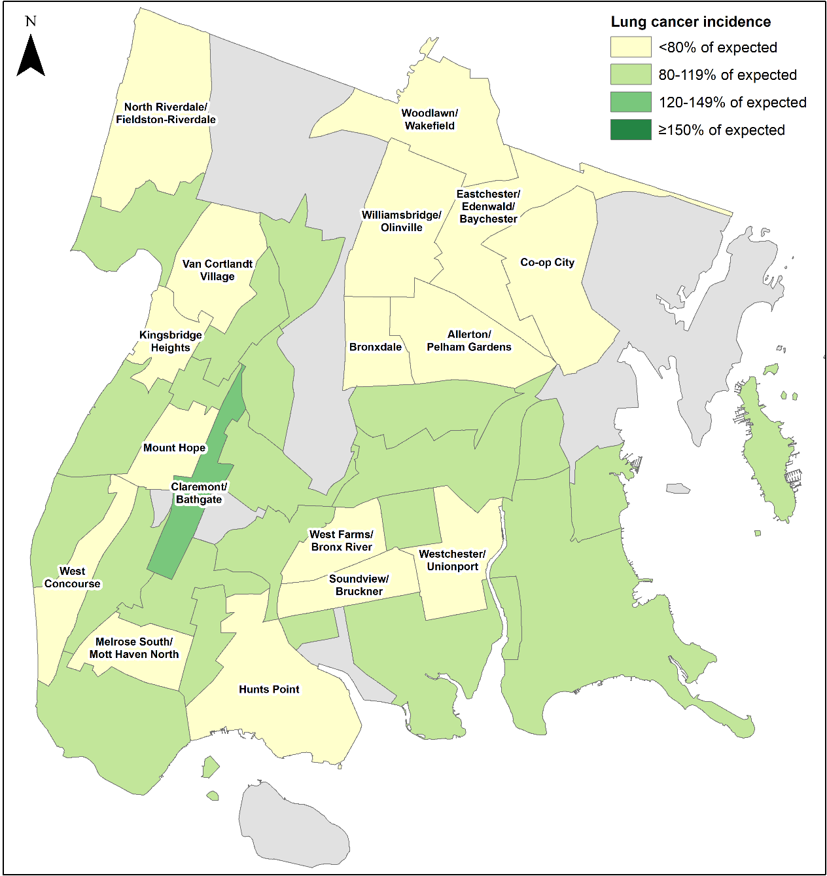
The incidence of lung cancer is below expected in most of the Bronx
Data source: NY State Cancer Registry, 2010-2014
Data is presented at the Neighborhood Tabulation Area (NTA)-level and is age- and sex-adjusted.

Slide 9
Mortality from lung cancer

Slide 10
Mortality rates from lung cancer have decreased among men but increased slightly among women in both the Bronx and NYC
Data source: New York State Cancer Registry, 1976-2016.
Notes:
UPDATED

Slide 11
In the Bronx, the mortality rate from lung cancer is highest among 80-84 year old men
Data source: New York State Cancer Registry, 2012-2016.
Notes:
UPDATED

Slide 12
In the Bronx, the mortality rate from lung cancer is highest among those who are non-Hispanic white and men
Data source: New York State Cancer Registry, 2012-2016.
Notes:
UPDATED

Slide 13
In the Bronx, mortality rates from lung cancer have declined among all race/ethnicity groups, but is still highest for the non-Hispanic white population
Data source: New York State Cancer Registry, 1992-2016.
Rates are age-adjusted to the 2000 US Std million (19 age groups) standard.
Notes:
UPDATED

Slide 14
Risk factors & protective factors

Slide 15
Risk factors for which there is strong evidence of an association with lung cancer and data available for the Bronx
Increases risk
Smoking
Ambient particulate matter (outdoor air pollution)
Decreases risk
Fruit consumption
Data source: World Cancer Research Fund International—Second Expert Report 2018.
Notes:
UPDATED – no change

Slide 16
The percent of current adult smokers across New York City has fallen since 2002, but remains highest for Staten Island
Data source: Community Health Survey, 2002-2017.
Staten Island 2010 data is likely an underestimate and 2011/2017 is likely an overestimate of the true prevalence of smoking due to random sampling variation.
Notes:
UPDATED

Slide 17
The Bronx has the lowest percentage of adults that report eating 5 or more servings of fruit and/or vegetables in a day
How many total servings of fruit and/or vegetables did you eat yesterday?
A serving equals one medium apple, a handful of broccoli, or a cup of carrots.
Distribution of Fruit & Vegetable Consumption in the Bronx (2016)
Data source: Community Health Survey, 2002-2016. Data not collected and available in 2003 and 2005-2007.
Notes:
UPDATED

Slide 18
Fine particulate concentrations are, on average, second highest in the Bronx, but have improved throughout NYC
Data source: New York City Community Air Survey, data from New York City Department of Health & Mental Hygiene Environment & Health Data Portal, 2017
Notes:
UPDATED

Slide 19
Potential risk factors for which there is strong evidence of an association with lung cancer, but no data available for the Bronx because it is difficult to ask about them in a survey
Increases risk
Industrial chemicals, such as aluminum, arsenic, and asbestos
Radon*
Arsenic in drinking water
Beta-carotene supplements
Decreases risk
Foods containing carotenoids
* Though not included in the 2007 Second Expert Report, indoor radon has more recently become established as a leading risk factor of lung cancer among nonsmokers.
Source: Noh J, Sohn J, Cho J, et al. Residential radon and environmental burden of disease among Non-smokers. Ann Occup Environ Med 2016;28:12.
Data source: World Cancer Research Fund International—Second Expert Report 2018.

Slide 20
About the Community Health Dashboard Project
The goal of the project is to provide Bronx-specific data on risk factors and health outcomes with an emphasis on presenting data on trends, socio-demographic differences (e.g., by age, sex, race/ethnicity, etc.) and sub-county/neighborhood level data
Data will be periodically updated as new data becomes available.
Produced by Montefiore’s Office of Community & Population Health using publicly-available data sources
For more information please contact us at OCPHDept@montefiore.org

