Slide 1
Bronx Community Health Dashboard: Smoking Created: 6/12/2017 Last Updated: 10/23/2017 See last slide for more information about this project.

Slide 2
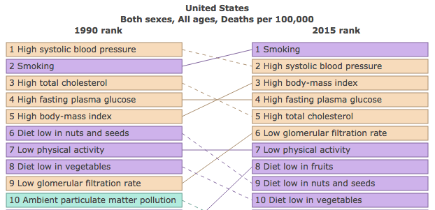
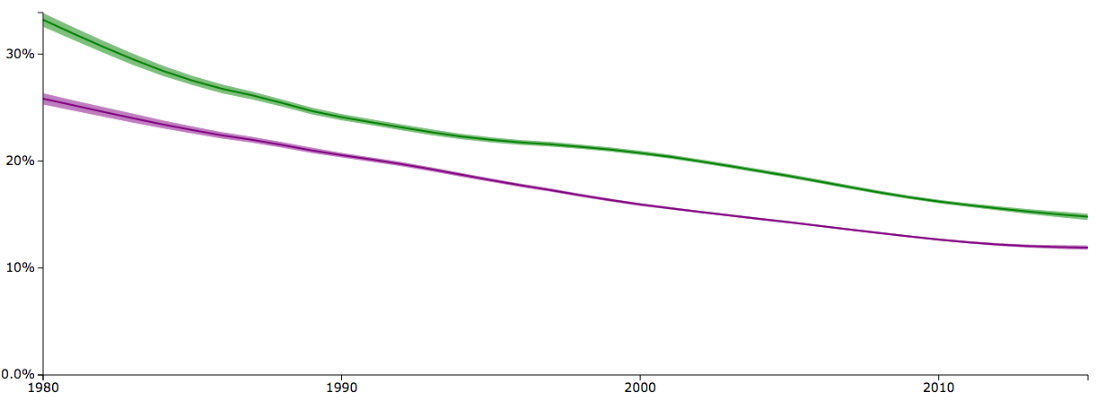
Daily smoking prevalence in the United States has declined since 1990 but rose to the leading risk factor for mortality amongst both sexes and all ages in 2015
Despite increasing in rank, smoking mortality rates in the United States have fallen 13.85%
Percent Daily Smoking Prevalence, USA
Data source: Global Burden of Disease Tobacco Viz, 2015
Data is age-adjusted.

Slide 3
Smoking Status

Slide 4
The percent of current adult smokers across New York City has fallen since 2002 but remains highest for Staten Island
Data source: Community Health Survey, 2002-2015. Analysis by Montefiore OCPH.
Staten Island 2010 data is likely an underestimate of the true prevalence of smoking due to random sampling variation.
Notes:
CURRENT SMOKER smoking status by borough

Slide 5
Fewer Bronx adults are current smokers and more Bronx adults report having never smoked in 2015, compared to 2002
Never Smoked
Current Smoker
2002
2015
14% increase
11% decrease
Data source: Community Health Survey, 2002, 2015. Analysis by Montefiore OCPH.
Data is age-adjusted.
Notes:
When did current smokers start smoking

Slide 6
Among Bronx adults there is a trend towards current smokers starting later in life, suggesting that tobacco prevention among youth is paying off
Results restricted to those who reported being a current or former smoker
Data source: Community Health Survey, 2002, 2015. Analysis by Montefiore OCPH.
”Regularly smoking cigarettes” not explicitly defined.

Slide 7
The Bronx has the third highest percent of current smokers of all New York City
Data source: Community Health Survey, 2015. Analysis by Montefiore OCPH.
Age results not age-adjusted.

Slide 8
In the Bronx, the unemployed, least educated, and most impoverished individuals are most likely to smoke
Data source: Community Health Survey, 2015. Analysis by Montefiore OCPH.
* Lowest Poverty data point is unstable.

Slide 9
Racial and ethnic disparities in current smokers have grown by 0.7 points in the previous 15 years
1.5
2.2
Data source: Community Health Survey, 2002-2015. Analysis by Montefiore OCPH.
Non-Hispanic white 2010, 2012-2014 data should be interpreted with caution. All Bronx Asian smoking data unstable.

Slide 10
3 of 10 community districts with highest percentages of current smokers are in the Bronx
Bronx 16
NYC 15
201 | Mott Haven & Melrose
202 | Hunts Point & Longwood
203 | Morrisania & Crotona
204 | Highbridge & Concourse
205 | Fordham & University Heights
206 | Belmont & East Tremont
207 | Kingsbridge Heights & Bedford
208 | Riverdale & Fieldston
209 | Parkchester & Soundview
210 | Throgs Neck & Co-op City
211 | Morris Park & Bronxdale
212 | Williamsbridge & Baychester
208
212
207
205
206
211
204
203
209
210
201
202
Data source: NYC Community Health Profiles.

Slide 11
The primary driver of the declining adult smoking rates in the Bronx is heavy smoking, which has fallen 3 fold since 2002
Heavy smokers: more than 10 cigarettes a day
Light smokers: between 1 and 10 cigarettes a day
Data source: Community Health Survey, 2002-2015. Analysis by Montefiore OCPH.
Data restricted to those that indicated they are current smokers.

Slide 12
Bronx residents are increasingly purchasing cigarettes in New York City stores
Data source: Community Health Survey, 2002-2015. Analysis by Montefiore OCPH.
Results restricted to current smokers whose most recent cigarette smoked was from a carton, pack or single/loosie.

Slide 13
Quit Attempts were consistent across all five boroughs between 2002 and 2013
Quit attempts defined as an attempt to quit smoking for 24 hours or longer during the past year
Data source: Community Health Survey, 2002-2015. Analysis by Montefiore OCPH.
Data not collected after 2013.

Slide 14
3 of 10 community districts with highest tobacco retailer rates are in the Bronx
Highest: Midtown
201 | Mott Haven & Melrose
202 | Hunts Point & Longwood
203 | Morrisania & Crotona
204 | Highbridge & Concourse
205 | Fordham & University Heights
206 | Belmont & East Tremont
207 | Kingsbridge Heights & Bedford
208 | Riverdale & Fieldston
209 | Parkchester & Soundview
210 | Throgs Neck & Co-op City
211 | Morris Park & Bronxdale
212 | Williamsbridge & Baychester
208
212
207
205
206
211
204
203
209
210
201
202
Note graph is depicted on log scale
Data source: NYC Community Health Profiles.

Slide 15
Youth Smoking

Slide 16
The percent of current youth smokers across New York City has fallen since 2003 but remains highest for Staten Island and lowest for the Bronx
Staten Island
Bronx
10.6% decrease
15.4% decrease
Data source: Youth Risk Behavior Survey, 2003-2015. Analysis by Montefiore OCPH.
Current smoker is defined as smoking at least one or more times in the previous 30 days.
Notes:
CURRENT SMOKER smoking status by borough

Slide 17
Fewer youth are currently smoking in the Bronx, but those that do smoke are primarily male, non-Hispanic white, and 18 years or older
Bronx only
Data source: Youth Risk Behavior Survey, 2015. Analysis by Montefiore OCPH.
Age results not age-adjusted.

Slide 18
Youth smoking in the Bronx used to be higher for female youth but now is higher amongst male youth
Data source: Youth Risk Behavior Survey, 2003-2015. Analysis by Montefiore OCPH.
Current smoker is defined as smoking at least one or more times in the previous 30 days.

Slide 19
Despite a decrease in the percentage of Bronx youth reporting being current smokers, an increasing percentage of youth that smoke are heavy smokers
Heavy smokers: more than 10 cigarettes a day
Heavy Smokers
Current Smokers
11% increase
26% decrease
Data source: Youth Risk Behavior Survey, 2003 - 2015. Analysis by Montefiore OCPH.
Data is age-adjusted. Heavy Smoker results restricted to students who smoked in the past 30 days.

Slide 20
Youth in the Bronx are less likely to get their cigarettes from someone else in 2015 and more likely to get them by other means
2003
2015
Data source: Youth Risk Behavior Survey, 2003, 2015. Analysis by Montefiore OCPH.
Data is age-adjusted. Results restricted to students who smoked in the past 30 days.

Slide 21
Health Consequences of Tobacco Use

Slide 22
Lung Cancer

Slide 23
Lung Cancer rates are highest for males in all boroughs, Bronx males have the second highest lung cancer incidence rate
Data source: New York State Cancer Registry, 2009-2013. Analysis by Montefiore OCPH.
Data is age-adjusted.

Slide 24
Bronx males have higher lung cancer incidence rates, though Bronx female lung cancer rates have risen nearly 16 points in the last 37 years
Data source: New York State Cancer Registry, 1976-2013. Analysis by Montefiore OCPH.
Data is age-adjusted.

Slide 25
The Bronx have the second highest rate of lung cancer mortality of all New York City boroughs
Data source: Underlying Cause of Death, 2000-2015. Analysis by Montefiore OCPH.
Data is age-adjusted.

Slide 26
Males in the Bronx consistently have higher lung cancer mortality rates than females, but rates have fallen 22 points
Data source: Underlying Cause of Death, 2000-2015. Analysis by Montefiore OCPH.
Data is age-adjusted.

Slide 27
Lung cancer mortality rates are highest in the Bronx amongst males, those 75 years and older, and in non-Hispanic white populations
Data source: Underlying Cause of Death, 2015. Analysis by Montefiore OCPH.
Age grouped data is not age-adjusted.

Slide 28
Racial and ethnic disparities in lung cancer mortality have fallen 10 points in the previous 15 years
28.9
18.9
Data source: Underlying Cause of Death, 2000-2015. Analysis by Montefiore OCPH.
Data is age-adjusted.

Slide 29
Chronic Lower Respiratory Disease
Notes:
chronic low resp disease j40-j47 ICD10 Codes

Slide 30
Chronic obstructive pulmonary disease (COPD) is the largest contributor to chronic lower respiratory disease mortality in the Bronx
Data source: Underlying Cause of Death, 2013-2015. Analysis by Montefiore OCPH.
Bronchitis sub-categories grouped due to unstable data.

Slide 31
The Bronx now has the highest chronic lower respiratory related mortality rates of all NYC boroughs
Data source: Underlying Cause of Death, 2000-2015. Analysis by Montefiore OCPH.
Data is age-adjusted.

Slide 32
Men in the Bronx have higher rates of chronic lower respiratory disease related mortality
Data source: Underlying Cause of Death, 2000-2015. Analysis by Montefiore OCPH.
Data is age-adjusted.

Slide 33
Chronic lower respiratory disease mortality rates are highest in the Bronx amongst males, those 75 years and older, and in non-Hispanic white populations
Data source: Underlying Cause of Death, 2015. Analysis by Montefiore OCPH.
Age group data is not age-adjusted.

Slide 34
Racial and ethnic disparities in chronic lower respiratory disease mortality have fallen nearly 4 points in the previous 15 years
12.4
8.6
Data source: Underlying Cause of Death, 2000-2015. Analysis by Montefiore OCPH.
Data is age-adjusted.

Slide 35
6 of 10 community districts with highest avoidable child asthma hospitalization rates are in the Bronx
Bronx 72
201 | Mott Haven & Melrose
202 | Hunts Point & Longwood
203 | Morrisania & Crotona
204 | Highbridge & Concourse
205 | Fordham & University Heights
206 | Belmont & East Tremont
207 | Kingsbridge Heights & Bedford
208 | Riverdale & Fieldston
209 | Parkchester & Soundview
210 | Throgs Neck & Co-op City
211 | Morris Park & Bronxdale
212 | Williamsbridge & Baychester
208
207
212
NYC 36
205
206
211
204
203
209
210
201
202
Data source: NYC Community Health Profiles.

Slide 36
6 of 10 community districts with highest asthma hospitalization rates are in the Bronx
Bronx 508
201 | Mott Haven & Melrose
202 | Hunts Point & Longwood
203 | Morrisania & Crotona
204 | Highbridge & Concourse
205 | Fordham & University Heights
206 | Belmont & East Tremont
207 | Kingsbridge Heights & Bedford
208 | Riverdale & Fieldston
209 | Parkchester & Soundview
210 | Throgs Neck & Co-op City
211 | Morris Park & Bronxdale
212 | Williamsbridge & Baychester
208
207
212
205
211
NYC 249
206
204
203
209
210
201
202
Data source: NYC Community Health Profiles.

Slide 37
Cardiovascular Disease
Chronic Heart Disease Includes:
Stroke/Cerebrovascular disease
Heart attack/myocardial infarction
Notes:
I60-I67 – ICD 10 Codes

Slide 38
Cardiovascular Disease Mortality Rates are highest in the Bronx compared to all other New York City boroughs
Data source: Underlying Cause of Death, 2000-2015. Analysis by Montefiore OCPH.
Data is age-adjusted.

Slide 39
Males in the Bronx consistently have higher chronic heart disease mortality rates than females
Data source: Underlying Cause of Death, 2000-2015. Analysis by Montefiore OCPH.
Data is age-adjusted.

Slide 40
Chronic heart disease mortality rates are highest in the Bronx amongst males, those 75 years and older, and in non-Hispanic black populations
Data source: Underlying Cause of Death, 2015. Analysis by Montefiore OCPH.
Age grouped data is not age-adjusted.

Slide 41
Racial and ethnic disparities in chronic heart disease mortality have fallen 6.6 points in the previous 15 years
10
3.4
Data source: Underlying Cause of Death, 2000-2015. Analysis by Montefiore OCPH.
Data is age-adjusted.

Slide 42
Diabetes

Slide 43
The Bronx has a higher prevalence of diabetes than all other NYC boroughs and peer counties
Bronx: +40%
Peer Counties Average: +31%
Data source: United States Diabetes Surveillance System, Division of Diabetes Translation, CDC. Data not comparable to NYC CHS data presented elsewhere.

Slide 44
Those 65 years and older, Females, and Hispanics have highest rates of diabetes in the Bronx in 2015
Not age-adjusted
Data source: New York City Community Health Survey, 2002-2015. Analysis by Montefiore OCPH.
Notes:
Diabetes Prevalence, Bronx 2015

Slide 45
Diabetes Mortality Rate has fallen by 10 percentage points over the last 15 years in the Bronx
Data source: Underlying Cause of Death, 1999-2015. Analysis by Montefiore OCPH.

Slide 46
Males have a higher diabetes mortality rate, adjusting for age in the Bronx
Data source: Underlying Cause of Death, 1999-2015. Analysis by Montefiore OCPH.
Notes:
Diabetes Mortality Rate by Gender, Adjusting for Age Bronx 2000-2015

Slide 47
About the Community Health Dashboard Project
The goal of the project is to provide Bronx-specific data on risk factors and health outcomes with an emphasis on presenting data on trends, socio-demographic differences (e.g., by age, sex, race/ethnicity, etc.) and sub-county/neighborhood level data
Data will be periodically updated as new data becomes available.
Produced by Montefiore’s Office of Community & Population Health using publicly-available data sources
For more information please contact Colin Rehm, PhD, Manager of Research & Evaluation (crehm@montefiore.org).

