Slide 1
Bronx Community Health Dashboard: Sexually Transmitted Diseases (STDs) Last Updated: 9/24/2019 See last slide for more information about this project.

Slide 2
Nationally, chlamydia and primary & secondary syphilis rates are on the rise; the gonorrhea rate was lowest in 2009, but has recently increased
Increasing rates may be due to improved STD screening.
Data source: CDC Wonder STD Morbidity Data, 2000-2014.
Notes:
UPDATED

Slide 3
Condom use is dropping among youth in NYC and the Bronx
Data source: Youth Risk Behavior Survey, 1997-2017.
Notes:
UPDATED

Slide 4
Condom use is dropping among both boys and girls in NYC, but remains higher among males
Data source: Youth Risk Behavior Survey, 1997-2017.
Notes:
UPDATED

Slide 5
Chlamydia
Chlamydia is a bacterial infection and can be treated with antibiotics. Long-term complications from untreated chlamydia in women include pelvic pain, infertility, and ectopic pregnancy. Men whose chlamydia infects the epididymis can experience pain, fever, and rarely, infertility. Both men and women can develop reactive arthritis.
Data note: All data are reported by labs and are not a measure of true incidence in the population as not all people seek care or are tested.

Slide 6
The chlamydia rate in the Bronx has increased by 122% and remains higher than other NYC boroughs
Data source: New York City STD Surveillance Data, 2000-2016.
Notes:
UPDATED

Slide 7
In the Bronx, those who are 15-24 year old, women, and non-Hispanic black have the highest chlamydia rates
Data source: New York City STD Surveillance Data, 2016.
Notes:
UPDATED

Slide 8
In the Bronx, the chlamydia rate has increased for both males and females, but remains higher for women
Data source: New York City STD Surveillance Data, 2000-2016.
Notes:
UPDATED

Slide 9
In the Bronx, the chlamydia rate has increased the most for 15-24 year olds and decreased among those <15y
Age groups with high burden of chlamydia
Age groups with lower burden of chlamydia
Data source: New York City STD Surveillance Data, 2000-2016.
Notes:
UPDATED

Slide 10
In the Bronx, the chlamydia rate has increased by 64% for 15-19 year old women
Age groups with high burden of chlamydia
Age groups with lower burden of chlamydia
Data source: New York City STD Surveillance Data, 2000-2016.
Notes:
UPDATED

Slide 11
In the Bronx, the chlamydia rate has increased in all race/ethnicity groups, but remains highest among the non-Hispanic black population
Data source: New York City STD Surveillance Data, 2000-2016
.
Notes:
UPDATED

Slide 12
In the Bronx, the chlamydia rate has increased by 4-fold among non-Hispanic black women
Data source: New York City STD Surveillance Data, 2000-2016.
Notes:
UPDATED

Slide 13
In New York City, the chlamydia rate increases as neighborhood poverty level increases
Data source: New York City STD Surveillance Data, 2016. *Federal poverty level
Notes:
UPDATED

Slide 14
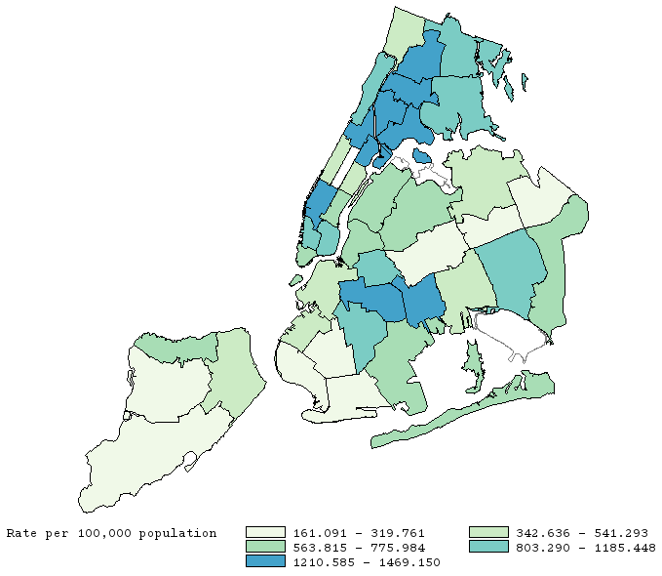
Four of the 10 neighborhoods with the highest chlamydia rates are in the Bronx
101
103
102
102
101 | Kingsbridge
102 | Northeast Bronx
103 | Fordham
104 | Pelham
105 | Crotona
106 | Morrisania
107 | Mott Haven
105
104
106
104
107
Data source: New York City STD Surveillance Data, 2016.
Notes:
UPDATED

Slide 15
Gonorrhea
Gonorrhea is a bacterial infection and can be treated with a combination of antibiotics. Untreated gonorrhea in women may lead to pelvic pain, infertility, and ectopic pregnancy. Men may experience scarring of the urethra. When gonorrhea spreads to the bloodstream, both men and women can experience arthritis, heart valve damage, or inflammation of the lining of the brain or spinal cord.
Data note: All data are reported by labs and are not a measure of true incidence in the population as not all people seek care or are tested.

Slide 16
The gonorrhea rate in the Bronx was higher than all other NYC boroughs until it was surpassed by Manhattan in 2014
Data source: New York City STD Surveillance Data, 2000-2016.
Notes:
UPDATED

Slide 17
In the Bronx, those who are 20-24 year old, men, and non-Hispanic black have the highest gonorrhea rates
Data source: New York City STD Surveillance Data, 2016.
Notes:
UPDATED

Slide 18
Gonorrhea rates were similar among men and women through the early 2010s, but have since diverged
Data source: New York City STD Surveillance Data, 2000-2016.
Notes:
UPDATED

Slide 19
In the Bronx, the gonorrhea rate is highest among those 15-29y
Data source: New York City STD Surveillance Data, 2000-2016.
Notes:
UPDATED

Slide 20
In the Bronx, the gonorrhea rate has increased by 87% for 25-29 year old men
Data source: New York City STD Surveillance Data, 2000-2016.
Notes:
UPDATED

Slide 21
In the Bronx, the gonorrhea rate has increased by 167% for those who are non-Hispanic black
Data source: New York City STD Surveillance Data, 2000-2016.
Notes:
UPDATED

Slide 22
In the Bronx, the gonorrhea rate has increased by 244% for non-Hispanic black men
Data source: New York City STD Surveillance Data, 2000-2016.
Notes:
UPDATED

Slide 23
In NYC, the gonorrhea rate increases as neighborhood poverty level increases
Data source: New York City STD Surveillance Data, 2016. *Federal poverty level
Notes:
UPDATED

Slide 24
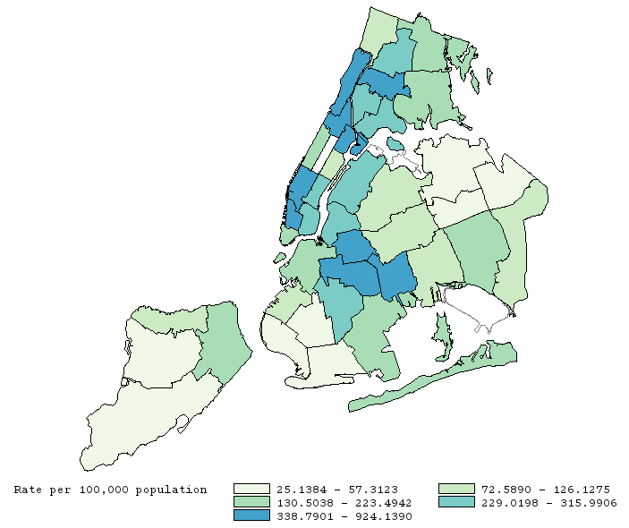
The burden of gonorrhea is highest in Chelsea/West village, Upper Manhattan, Central Brooklyn, and the South Bronx
101
102
101 | Kingsbridge
102 | Northeast Bronx
103 | Fordham
104 | Pelham
105 | Crotona
106 | Morrisania
107 | Mott Haven
103
102
105
104
104
106
107
Data source: New York City STD Surveillance Data, 2016.
Notes:
UPDATED

Slide 25
Primary and secondary (P&S) syphilis
Primary syphilis is the first stage of syphilis. Individuals with primary syphilis tend to have sores at the original site of infection. If untreated, it may progress to secondary syphilis, symptoms of which include skin rash, swollen lymph nodes, and fever.
Individuals recently infected with syphilis are likely to be co-infected with HIV.
Data note: All data are reported by labs and are not a measure of true incidence in the population as not all people seek care or are tested.

Slide 26
The Bronx’s P&S syphilis rate has increased over 20-fold since 2000
Data source: New York City STD Surveillance Data, 2000-2016.
Notes:
UPDATED

Slide 27
In the Bronx, the P&S syphilis rate is higher for men than women
Men only
Data source: New York City STD Surveillance Data, 2016.
Notes:
UPDATED

Slide 28
In the Bronx, the P&S syphilis rate has increased 90-fold among 25-29 year old men
Data source: New York City STD Surveillance Data, 2000-2016
.
Notes:
UPDATED

Slide 29
In the Bronx, the P&S syphilis rate has increased nearly 30-fold among non-Hispanic black men
Data source: New York City STD Surveillance Data, 2000-2016.
Notes:
UPDATED

Slide 30
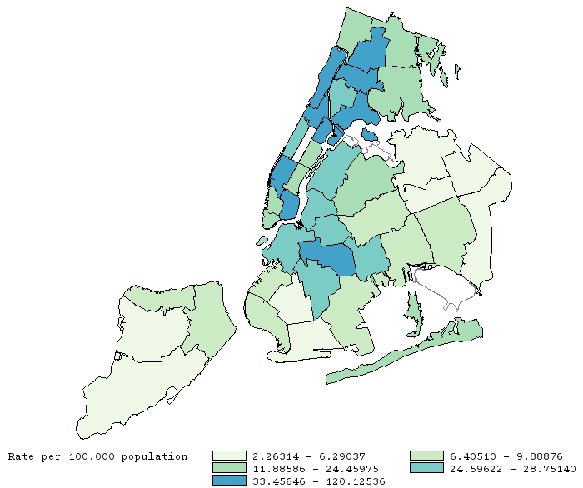
Three of the 10 neighborhoods with the highest P&S syphilis rates are in the Bronx
101
101 | Kingsbridge
102 | Northeast Bronx
103 | Fordham
104 | Pelham
105 | Crotona
106 | Morrisania
107 | Mott Haven
103
102
105
104
106
107
Data source: New York City STD Surveillance Data, 2016.
Notes:
UPDATED

Slide 31
About the Community Health Dashboard Project
The goal of the project is to provide Bronx-specific data on risk factors and health outcomes with an emphasis on presenting data on trends, socio-demographic differences (e.g., by age, sex, race/ethnicity, etc.) and sub-county/neighborhood level data
Data will be periodically updated as new data becomes available.
Produced by Montefiore’s Office of Community & Population Health using publicly-available data sources
For more information please contact us at OCPHDept@montefiore.org

