Slide 1
Bronx Community Health Dashboard: Mental Health Last Updated: 1/23/2018 See last slide for more information about this project.

Slide 2
Mental and behavioral disorders are the third leading cause of disability in the US
$233
billion
Annual cost of depression in the United States (in 2016 dollars)
Source: Bremner, Am J Psych, 2003.
Data source: Global Burden of Disease Project, 2016.

Slide 3
Serious psychological distress
Serious psychological distress is determined by responses to six questions regarding feeling sad, nervous, restless, hopeless, that everything is an effort and worthless. This tool is called the Kessler 6 inventory.

Slide 4
Both the Bronx and the rest of NYC have experienced a decline in the prevalence of serious psychological distress
Data source: New York City Community Health Survey, 2002-2015.

Slide 5
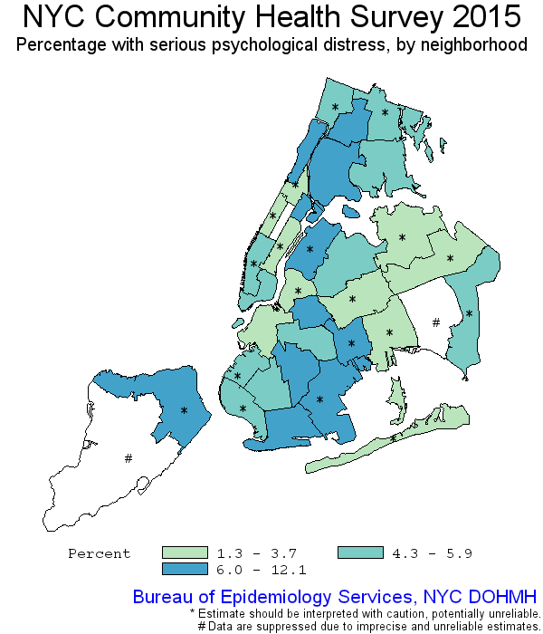
Bronx neighborhood with the highest prevalence of serious psychological distress is South Bronx
101
101 | Kingsbridge
102 | NE Bronx
103 | Fordham-Bronx Pk
104 | Pelham-Throgs Neck
105/106/107 | South Bronx
103
102
105
106
107
104
Data source: New York City Community Health Survey, 2015.

Slide 6
Bronx has the highest prevalence of serious psychological distress. In the Bronx, females and Hispanics have the highest prevalence of serious psychological distress
Bronx only
Data source: New York City Community Health Survey, 2015.

Slide 7
Diagnosed depression

Slide 8
The percent of adults first diagnosed with depression in the past year has increased in the Bronx and remains higher than the rest of NYC
Data source: New York City Community Health Survey, 2006-2013.

Slide 9
The Bronx has the highest percent of adults first diagnosed with depression in the past year. In the Bronx, females and Hispanics have the highest prevalence of first diagnosis of depression in the past year
Bronx only
Data source: New York City Community Health Survey, 2013.

Slide 10
The percent of adults with history of depression has decreased slightly in the Bronx but remains higher than the rest of NYC
Data source: New York City Community Health Survey, 2005-2014.

Slide 11
The Bronx has the second highest percent of adults with history of depression. In the Bronx, females and non-Hispanic whites have the highest prevalence of history of depression
Bronx only
Data source: New York City Community Health Survey, 2014.

Slide 12
Access to mental health services

Slide 13
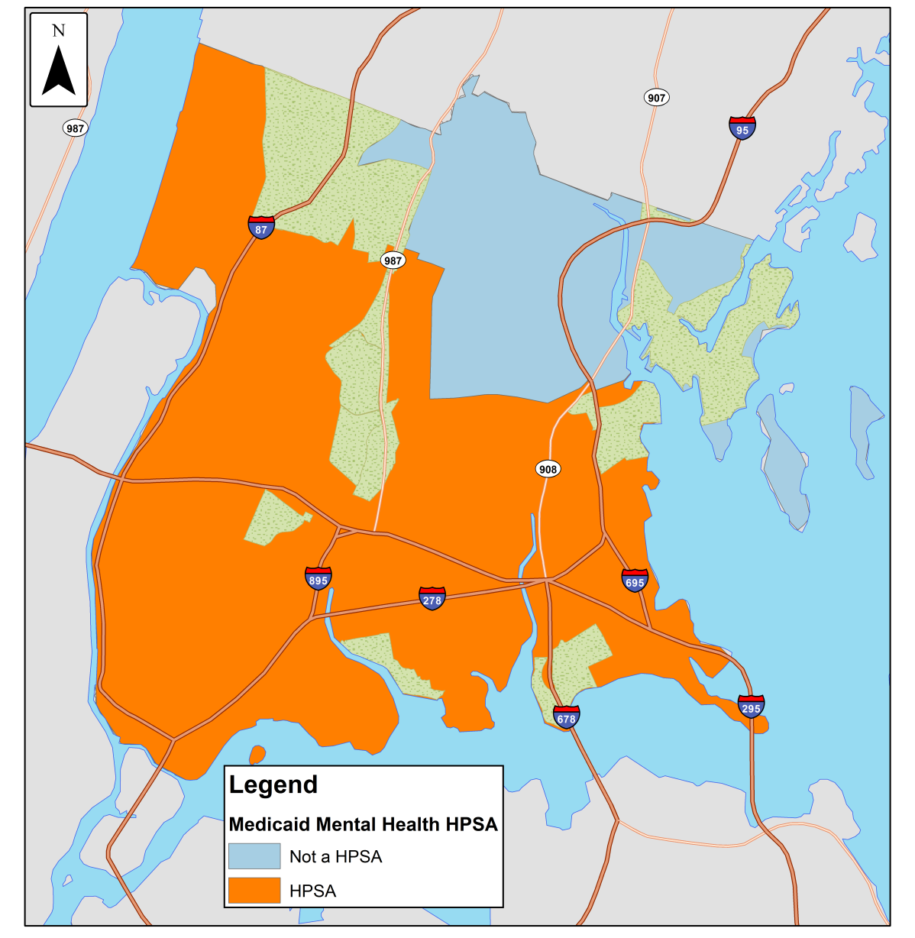
91% of the population insured by Medicaid in the Bronx lives in a Mental Health Professional Shortage Areas
A Medicaid mental health “Health Professional Shortage Area” (HPSA) is defined by a combination of the ratio of mental health providers to the population and the needs of the population.
Designated HPSA areas may benefit from government programs to increase the accessibility of mental health services.
Data source: HRSA Data Warehouse and 2012-2016 American Community Survey

Slide 14
Psychiatric hospitalizations

Slide 15
Bronx has the highest rate of psychiatric hospitalizations
Data source: New York State SPARCS data, 2015 reported in the NYC Community Health Profiles.

Slide 16
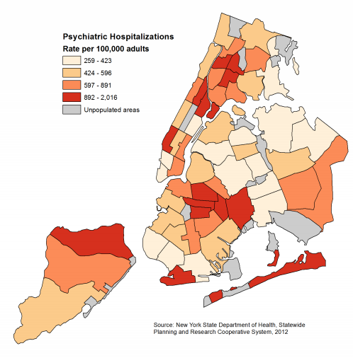
In the Bronx, Morrisania and Crotona has the highest rate of psychiatric hospitalizations
201 | Mott Haven & Melrose
202 | Hunts Point & Longwood
203 | Morrisania & Crotona
204 | Highbridge & Concourse
205 | Fordham & University Heights
206 | Belmont & East Tremont
207 | Kingsbridge Heights & Bedford
208 | Riverdale & Fieldston
209 | Parkchester & Soundview
210 | Throgs Neck & Co-op City
211 | Morris Park & Bronxdale
212 | Williamsbridge & Baychester
208
212
207
205
206
211
204
203
209
210
201
202
Data source: New York State SPARCS data, 2015 reported in the NYC Community Health Profiles.

Slide 17
Suicide attempts among youth

Slide 18
The percent of youth attempting suicide has increased by 25% in the Bronx since 2003
Data source: New York City Youth Risk Behavior Survey, 2003-2015.

Slide 19
In the Bronx, suicide attempts are decreasing for girls, but increasing for boys
Data source: New York City Youth Risk Behavior Survey, 1997-2015.

Slide 20
In the Bronx, suicide attempts have increased the most for non-Hispanic black youth
Data source: New York City Youth Risk Behavior Survey, 1999-2015.

Slide 21
Suicide mortality

Slide 22
For both the Bronx and the rest of NYC, the mortality rate from suicide has remained relatively stable
Data source: Underlying Cause of Death, 1999-2015.

Slide 23
In the Bronx, males and non-Hispanic whites have the highest mortality rates from suicide
Nationwide, 51% of suicides are firearm-related
Data source: Underlying Cause of Death, 2010-2015. Age specific rates not age-adjusted.

Slide 24
In the Bronx, the mortality rate from suicide remains higher among males
Data source: Underlying Cause of Death, 2000-2015.

Slide 25
In the Bronx, the mortality rate from suicide has remained relatively stable among Hispanics and non-Hispanic whites, but increased among non-Hispanic blacks
Data source: Underlying Cause of Death, 2000-2015.

Slide 26
Non-Hispanic white males have higher mortality rates from suicide than Hispanic and non-Hispanic black males
Data source: Underlying Cause of Death, 2008-2015. Age specific rates not age-adjusted.
Data unreliable for women 65-74 and ≥75y.

Slide 27
Among New York State counties, the Bronx has the second lowest suicide mortality rate
Data source: Underlying Cause of Death from CDC Wonder, 2011-2016.

Slide 28
About the Community Health Dashboard Project
The goal of the project is to provide Bronx-specific data on risk factors and health outcomes with an emphasis on presenting data on trends, socio-demographic differences (e.g., by age, sex, race/ethnicity, etc.) and sub-county/neighborhood level data
Data will be periodically updated as new data becomes available.
Produced by Montefiore’s Office of Community & Population Health using publicly-available data sources
For more information please contact Colin Rehm, PhD, Manager of Research & Evaluation (crehm@montefiore.org).

