Slide 1
Bronx Community Health Dashboard: Diabetes Last Updated: 4/19/2019 See last slide for more information about this project.

Slide 2
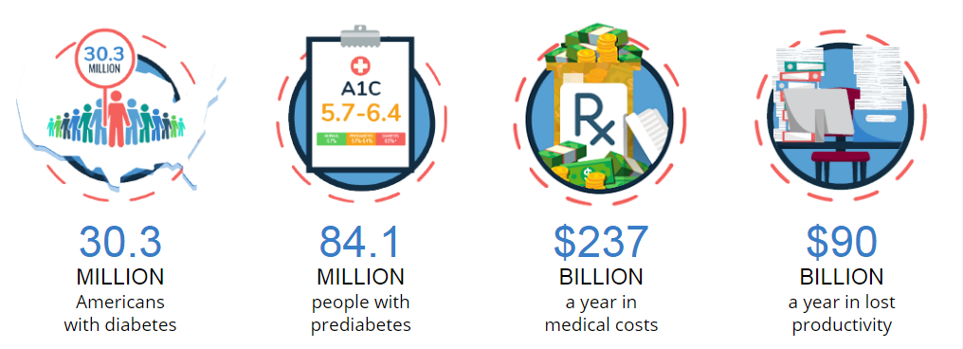
Diabetes exerts a tremendous economic & health toll
Statistics for the entire United States
+796% increase in prevalence of diabetes from late 1950s to 2014
From 0.93% to 7.40%
Data source: Centers for Disease Control and Prevention. Division of Diabetes Translation At A Glance

Slide 3
Diabetes is a leading cause of morbidity & mortality in New York State
In New York State in 2017, diabetes was the fifth leading cause of morbidity + mortality.
Burden increasing
Burden decreasing
Diabetes has experienced the 2nd highest annual increase in morbidity + mortality in New York State since 1990, trailing only drug use disorders
Data source: 2017 Global Burden of Disease Project. DALY = Disability Adjusted Life Years and is a measure that captures the impact of a risk factor or condition on total health, including both morbidity (i.e., disability) and mortality. Analysis limited to top 20 causes.

Slide 4
The Bronx has the highest prevalence of diabetes in NYC and it continues to increase
Data source: New York City Community Health Survey, 2002-2017.
Notes:
Diabetes Prevalence by NYC Borough, 2002-2015

Slide 5
Older residents, women, Hispanic and non-Hispanic black populations and those with less education have the highest burden of diabetes
Not age-adjusted
Data source: New York City Community Health Survey, 2017. NHB: non-Hispanic black; NHW: non-Hispanic white
Notes:
Diabetes Prevalence, Bronx 2015

Slide 6
Adults with the least education have the highest prevalence of diabetes and disparities are increasing
Data source: New York City Community Health Survey, 2002-2017.
Notes:
Diabetes Prevalence by NYC Borough, 2002-2015

Slide 7
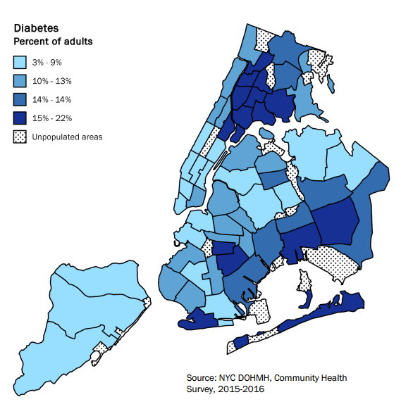
8 out of 10 Community Districts with the highest prevalence of diabetes are in the Bronx
208
212
207
205
206
211
204
203
209
210
201
202
201 | Mott Haven & Melrose
202 | Hunts Point & Longwood
203 | Morrisania & Crotona
204 | Highbridge & Concourse
205 | Fordham & University Heights
206 | Belmont & East Tremont
207 | Kingsbridge Heights & Bedford
208 | Riverdale & Fieldston
209 | Parkchester & Soundview
210 | Throgs Neck & Co-op City
211 | Morris Park & Bronxdale
212 | Williamsbridge & Baychester
Data source: NYC Community Health Profiles.

Slide 8
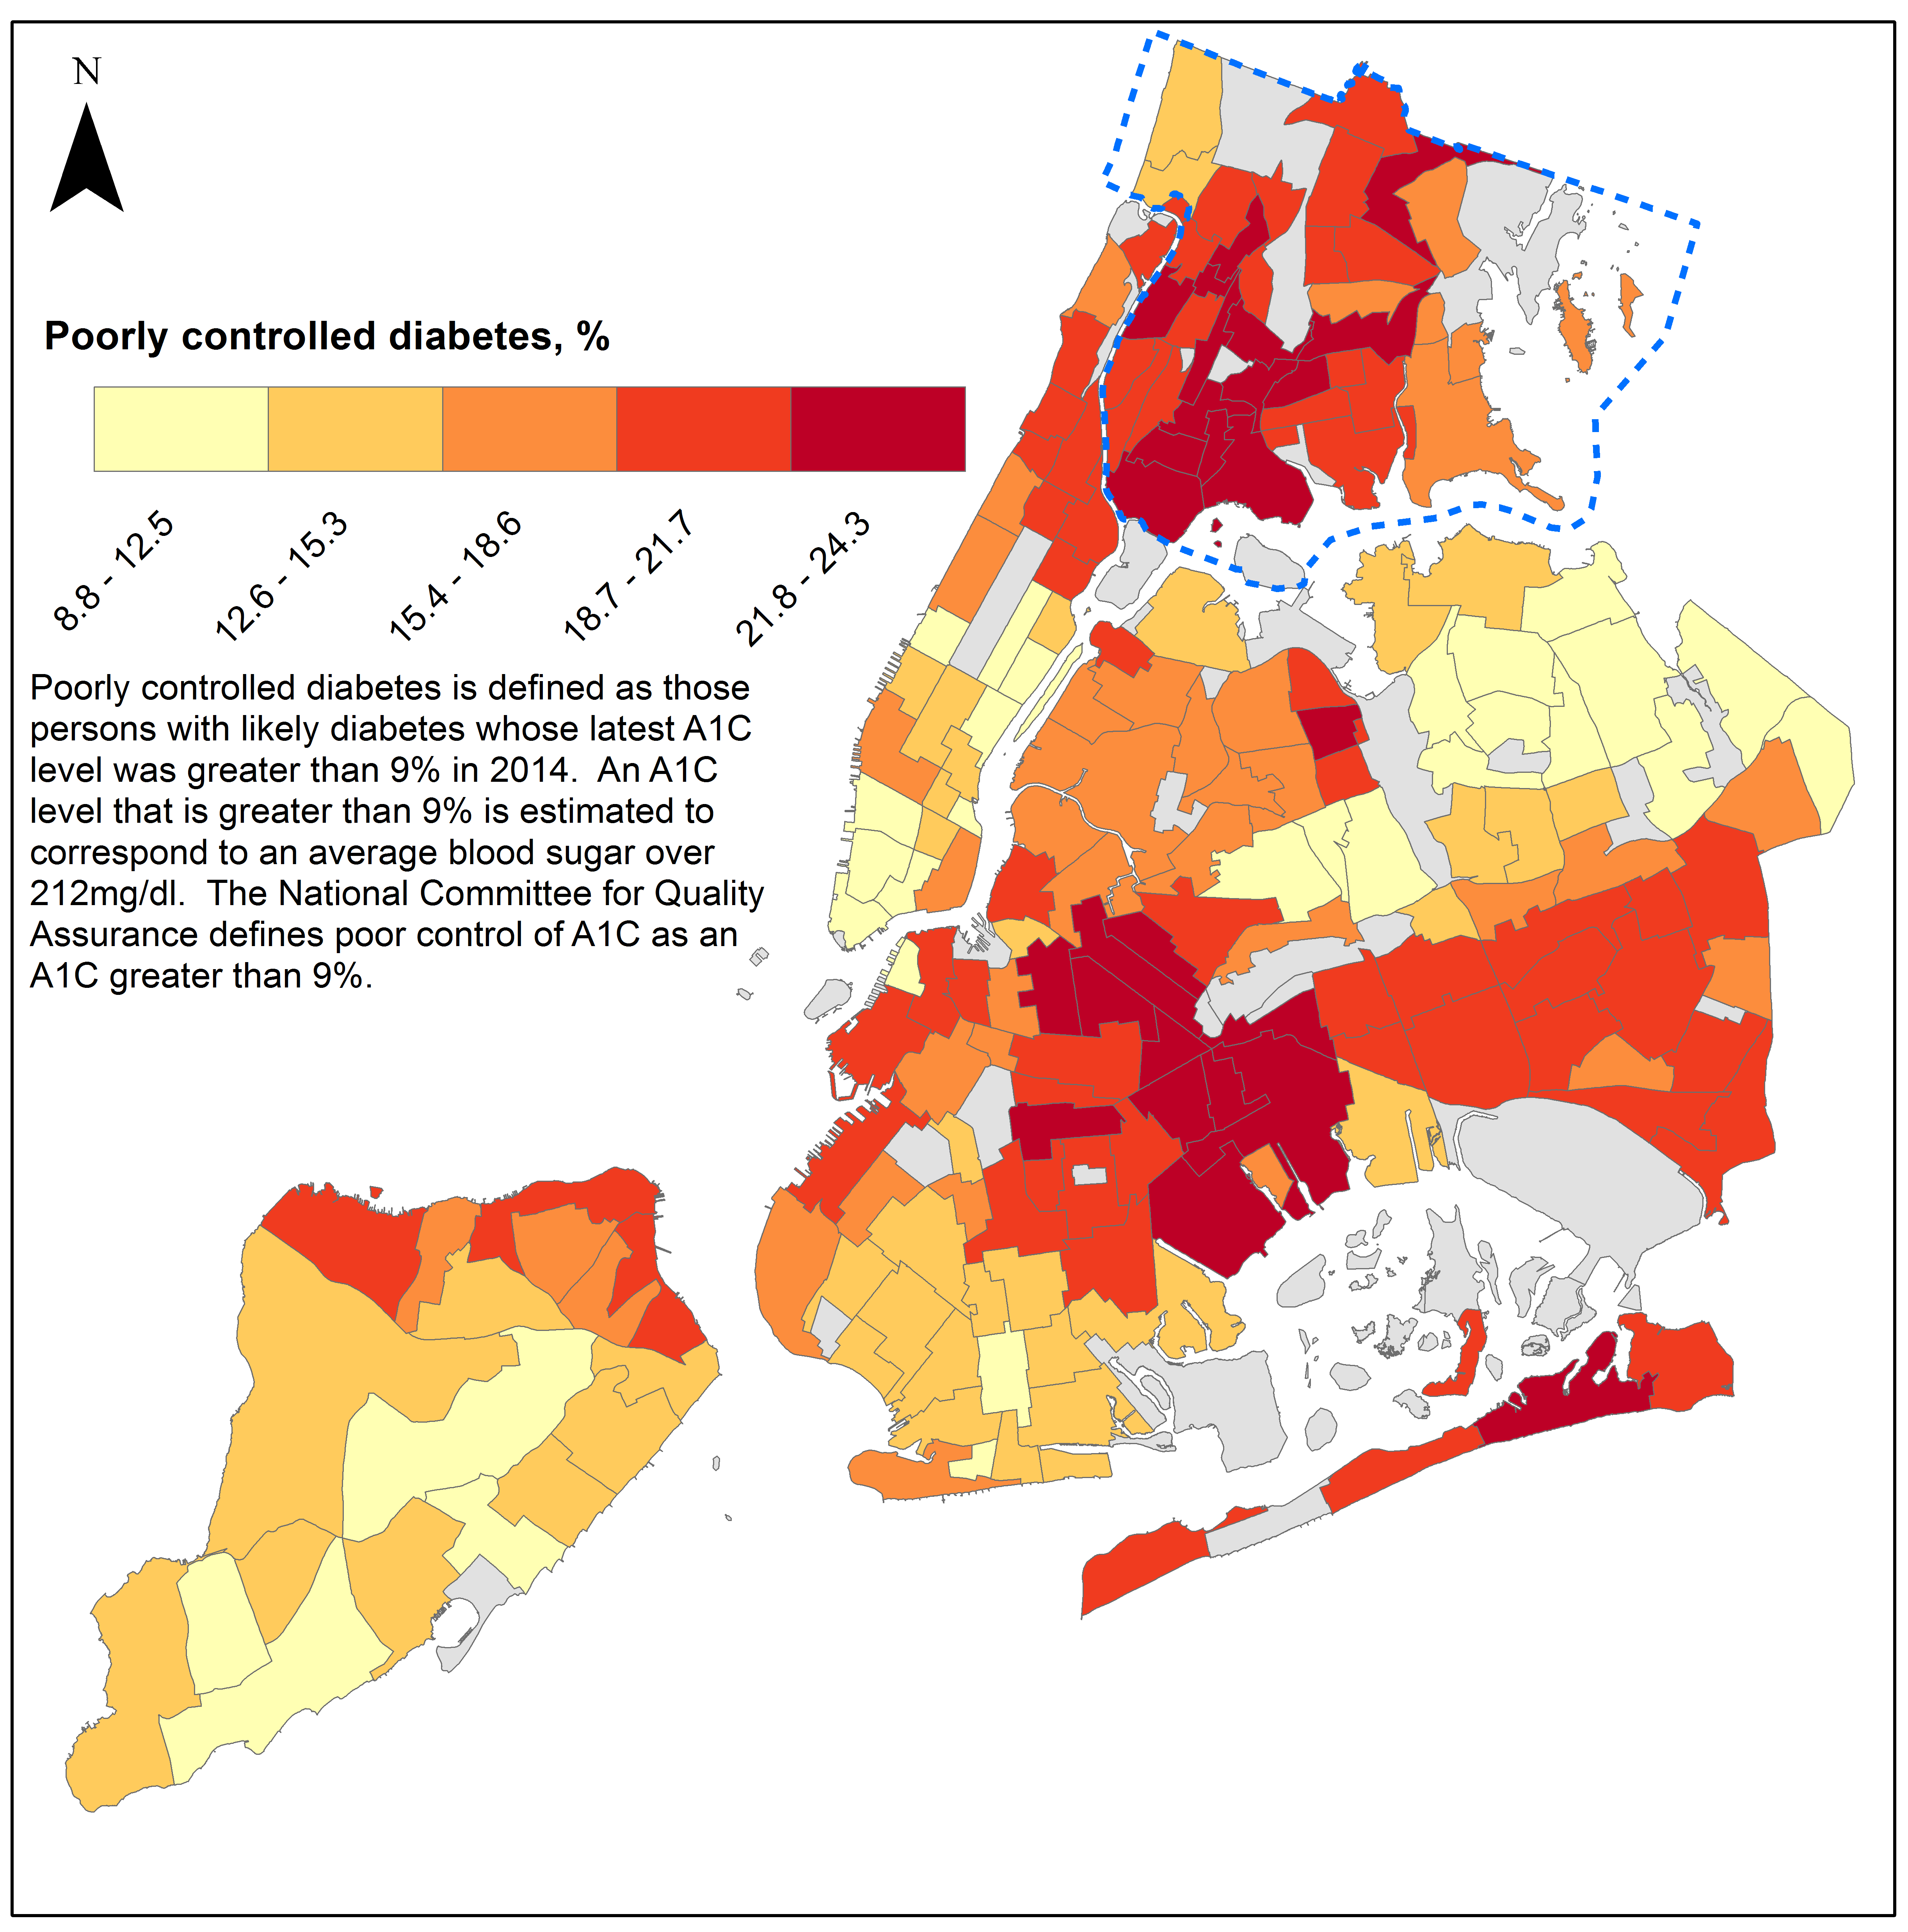
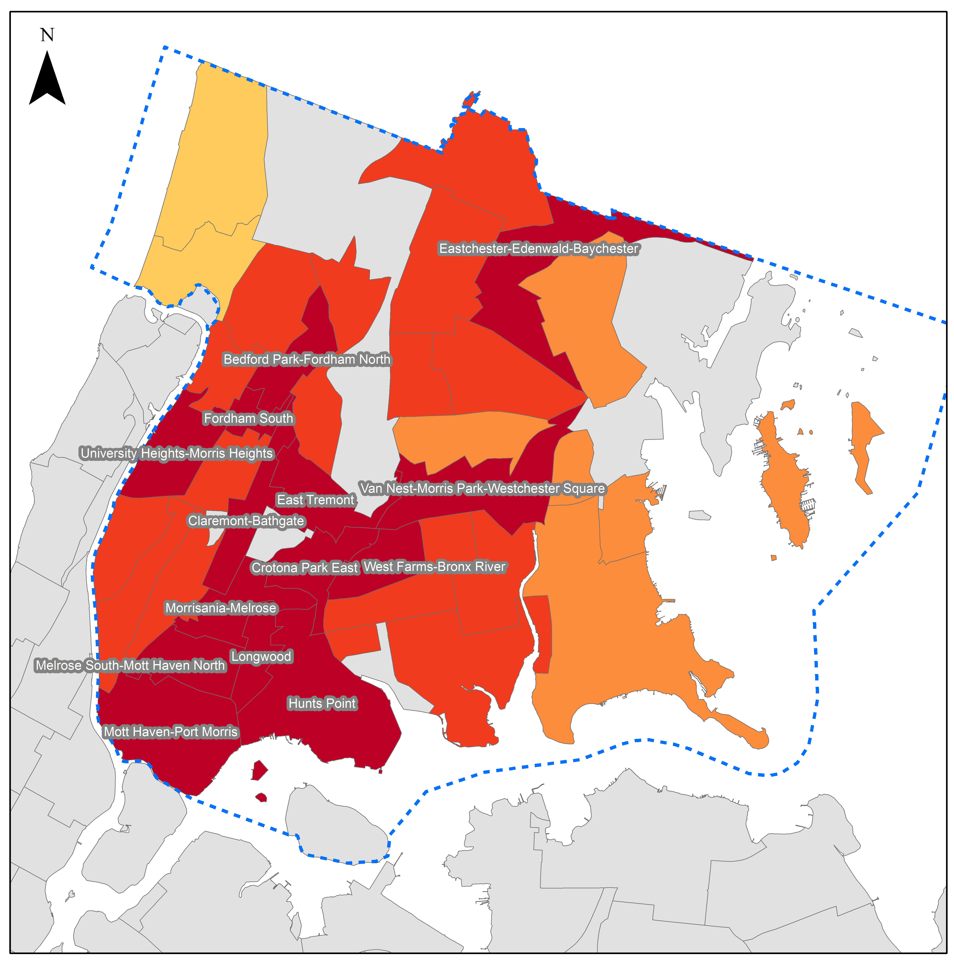
Poor diabetes control is clustered in the Bronx and Central Brooklyn
Data is by Neighborhood Tabulation Area (NTA)
Data source: NYC A1C Registry, 2014

Slide 9
Diabetes Hospitalizations

Slide 10
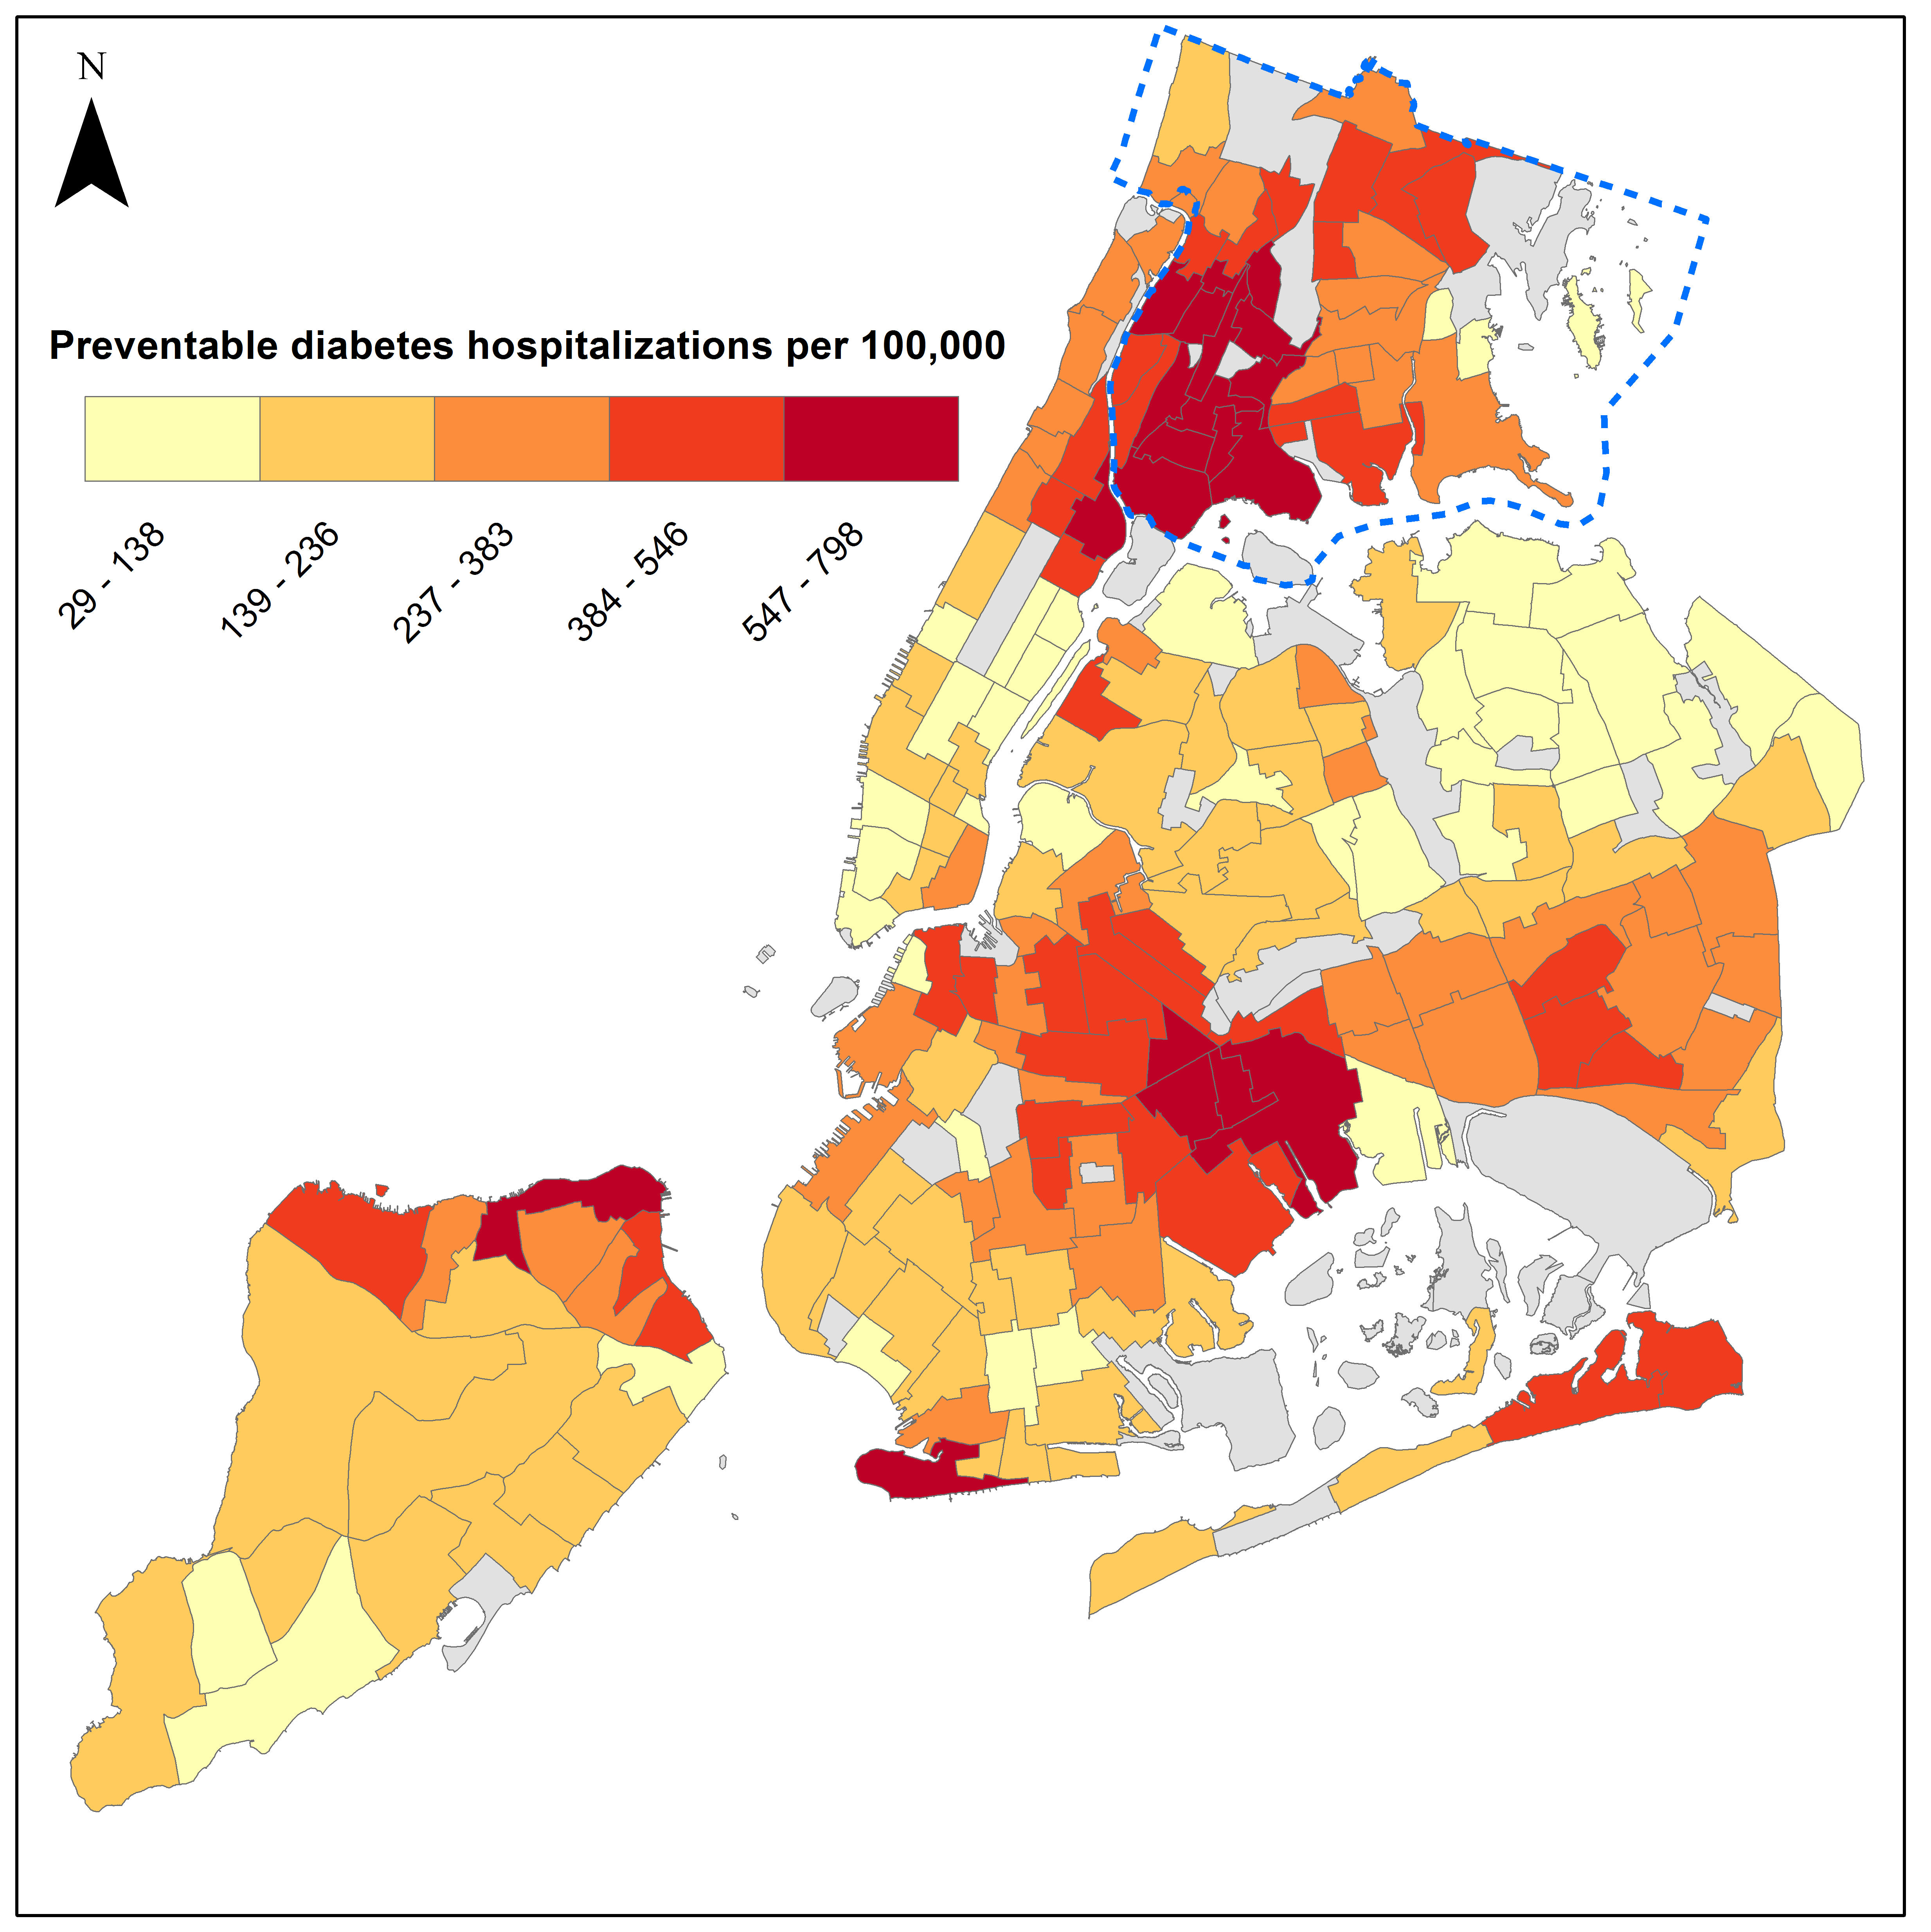
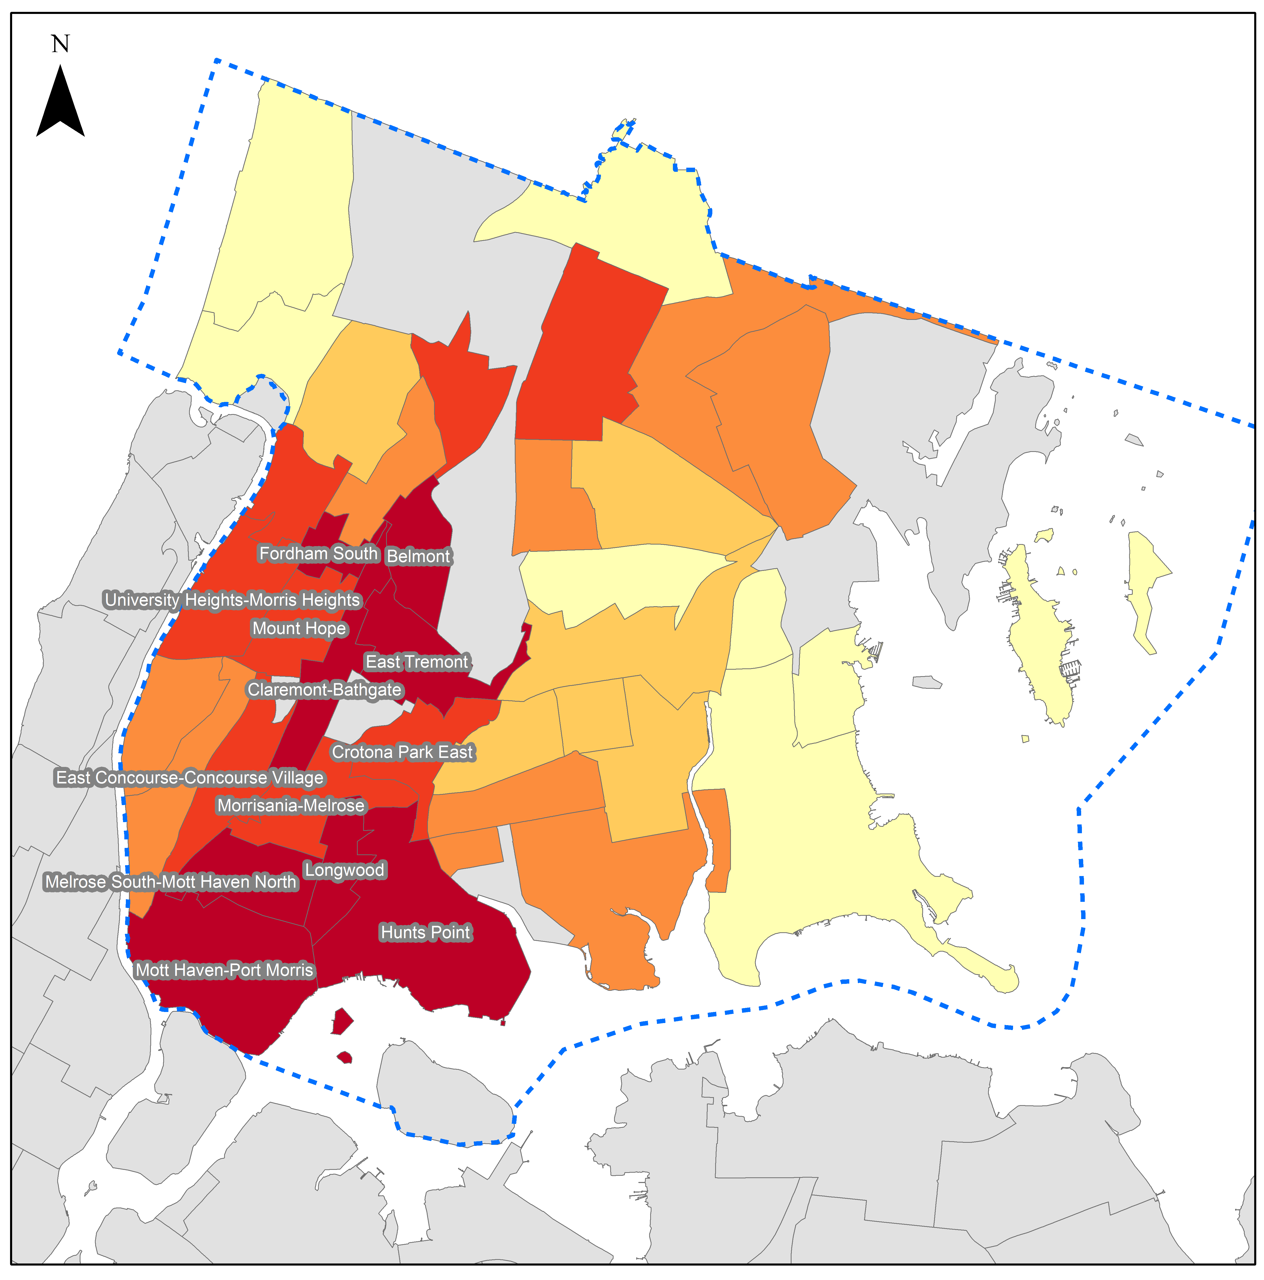
Preventable diabetes hospitalizations are highest in the South Bronx
Data is by Neighborhood Tabulation Area (NTA)
Includes principal or other diagnosis of ICD-9 codes 250.10-250.33, 250.40-250.93, 250.02-250.03, 841.0-841.9, or 250.00-250.93.
Data source: SPARCS, 2012-2014. Data are age-adjusted.

Slide 11
Diabetes Mortality

Slide 12
The diabetes mortality rate has fallen by 38% over the last 17 years in the Bronx, but remains higher than NYC
Data source: Underlying Cause of Death, 2000-2017.

Slide 13
Diabetes mortality has declined among both sexes, but the drop is larger for women
Data source: Underlying Cause of Death, 2000-2017.

Slide 14
Racial/ethnic disparities in diabetes mortality have declined in the Bronx, but remain highest for non-Hispanic black residents
Data source: Underlying Cause of Death, 2000-2017. NHB is non-Hispanic black; NHW is non-Hispanic white.

Slide 15
Among all age groups, the diabetes mortality rate has declined in the Bronx
Data source: Underlying Cause of Death, 2000-2017. Data are not age-adjusted.

Slide 16
Out of 59 Community Districts, the Bronx has 2 of 5 highest diabetes mortality rates
201 | Mott Haven & Melrose
202 | Hunts Point & Longwood
203 | Morrisania & Crotona
204 | Highbridge & Concourse
205 | Fordham & University Heights
206 | Belmont & East Tremont
207 | Kingsbridge Heights & Bedford
208 | Riverdale & Fieldston
209 | Parkchester & Soundview
210 | Throgs Neck & Co-op City
211 | Morris Park & Bronxdale
212 | Williamsbridge & Baychester
Data source: NYC Mortality Data, 2016.
Notes:
map of NYC and diabetes mortality rate will be added in

Slide 17
About the Community Health Dashboard Project
The goal of the project is to provide Bronx-specific data on risk factors and health outcomes with an emphasis on presenting data on trends, socio-demographic differences (e.g., by age, sex, race/ethnicity, etc.) and sub-county/neighborhood level data
Dashboards will be periodically updated as new data becomes available.
Produced by Montefiore’s Office of Community & Population Health using publicly-available data sources
For more information please contact us at OCPHDept@montefiore.org

