Slide 1
Bronx Community Health Dashboard: Smoking Created: 6/12/2017 Last Updated: 3/2/2019 See last slide for more information about this project.

Slide 2
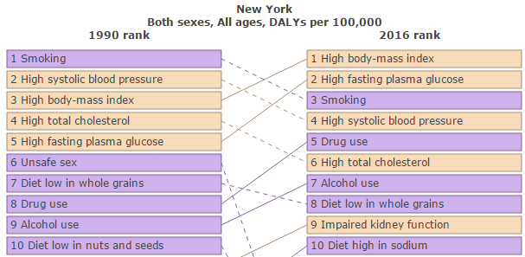
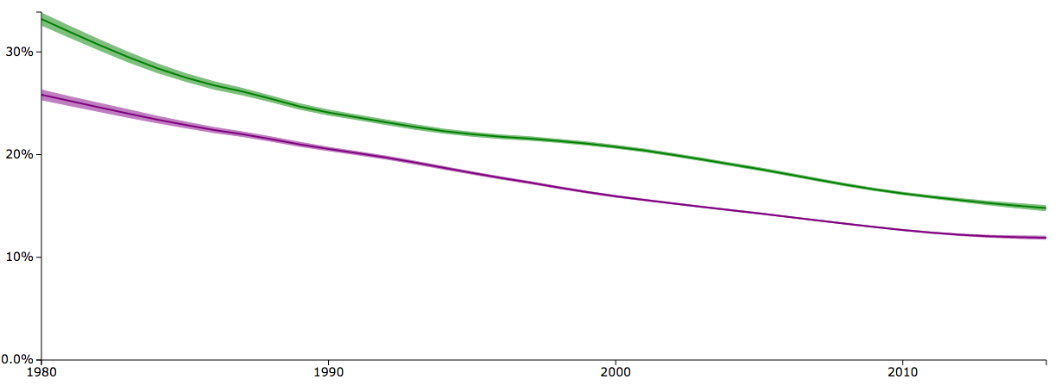
Daily smoking prevalence in the United States has declined since 1990 but remains a leading cause of ill health
United States: 1980-2015
Despite major declines in smoking prevalence, smoking remains a top 3 cause of ill health in New York state.
Percent Daily Smoking Prevalence, USA
Data source: Global Burden of Disease Tobacco Viz, 2015. GBD Compare 2016.

Slide 3
Adult Smoking Status

Slide 4
The percent of current adult smokers has fallen across NYC since 2002
Data source: Community Health Survey, 2002-2016.
Staten Island 2010 data is likely an underestimate of the true prevalence of smoking due to random sampling variation.
Notes:
CURRENT SMOKER smoking status by borough

Slide 5
Fewer Bronx adults are current smokers and more Bronx adults have never smoked in 2016 compared to 2002
Never smoked
Current smoker
2002
2016
25% increase
44% decrease
Data source: Community Health Survey, 2002, 2016.
Data is age-adjusted.
Notes:
When did current smokers start smoking

Slide 6
In the Bronx, men are much more likely to be current smokers than women
Bronx only
Data source: Community Health Survey, 2016.
Age results not age-adjusted. * Data points are statistically unstable.

Slide 7
In the Bronx, unemployed adults and those with less education are more likely to smoke
Data source: Community Health Survey, 2016.
* Data point is statistically unstable.

Slide 8
The percent of current smokers has declined across all groups, but is slightly higher among the non-Hispanic white population
Data source: Community Health Survey, 2002-2016.
Non-Hispanic white 2010, 2012-2014 data should be interpreted with caution due to small numbers.
Smoking data for Asian group is statistically unstable.

Slide 9
3 of 10 community districts with highest percentages of current smokers are in the Bronx
Bronx 16
NYC 15
201 | Mott Haven & Melrose
202 | Hunts Point & Longwood
203 | Morrisania & Crotona
204 | Highbridge & Concourse
205 | Fordham & University Heights
206 | Belmont & East Tremont
207 | Kingsbridge Heights & Bedford
208 | Riverdale & Fieldston
209 | Parkchester & Soundview
210 | Throgs Neck & Co-op City
211 | Morris Park & Bronxdale
212 | Williamsbridge & Baychester
208
212
207
205
206
211
204
203
209
210
201
202
Data source: NYC Community Health Profiles, 2015.
Data is age-adjusted.

Slide 10
The primary driver of the declining adult smoking rates in the Bronx is heavy smoking, which has fallen 64% since 2002
Heavy smokers: more than 10 cigarettes per day
Light smokers: between 1 and 10 cigarettes per day
Data source: Community Health Survey, 2002-2016.
Data restricted to those that indicated they are current smokers.

Slide 11
Quit attempts were consistent across all five boroughs between 2002 and 2013
Quit attempts defined as an attempt to quit smoking for 24 hours or longer during the past year among adults who were smokers in the past year.
Data source: Community Health Survey, 2002-2015.
Data not collected after 2013.

Slide 12
3 of 10 community districts with highest tobacco retailer rates are in the Bronx
Highest: Midtown
Bronx 11
201 | Mott Haven & Melrose
202 | Hunts Point & Longwood
203 | Morrisania & Crotona
204 | Highbridge & Concourse
205 | Fordham & University Heights
206 | Belmont & East Tremont
207 | Kingsbridge Heights & Bedford
208 | Riverdale & Fieldston
209 | Parkchester & Soundview
210 | Throgs Neck & Co-op City
211 | Morris Park & Bronxdale
212 | Williamsbridge & Baychester
208
212
207
205
206
211
204
203
209
210
201
202
Note graph is depicted on log scale
Data source: NYC Community Health Profiles, 2015.
Data is age-adjusted.

Slide 13
Youth Smoking

Slide 14
The percent of current youth smokers across NYC has fallen since 2003 but remains highest in Staten Island and lowest in the Bronx
Data source: Youth Risk Behavior Survey, 2003-2017.
Current smoker is defined as smoking at least one or more times in the previous 30 days.

Slide 15
Fewer youth are currently smoking in the Bronx, but male, older and Hispanic youth are more likely to smoke
Bronx only
Data source: Youth Risk Behavior Survey, 2017.
Non-Hispanic white excluded due to small sample size.
Current smoker is defined as smoking at least one or more times in the previous 30 days.

Slide 16
Smoking in the Bronx used to be higher for female youth but is now marginally higher for males
Data source: Youth Risk Behavior Survey, 2003-2017.
Current smoker is defined as smoking at least one or more times in the previous 30 days.

Slide 17
Of Bronx youth reporting being current smokers, a declining percentage are daily smokers
Frequent smokers: 20+ days in past 30 days, including daily
Occasional smokers: 1-19 days in past 30 days
Data source: Youth Risk Behavior Survey, 2003 - 2017.
Current smoker is defined as smoking at least one or more times in the previous 30 days.

Slide 18
Over one-third of Bronx youth smokers get cigarettes from stores
2003
2015
Data source: Youth Risk Behavior Survey, 2003, 2015. Data not collected after 2015.
Results restricted to students who smoked in the past 30 days.
Notes:
Stopped asking in 2017

Slide 19
The percentage of youth who currently use e-cigarettes has increased since 2015, and is highest in Staten Island
E-cigarettes are also called e-cigs, vapes, e-hookahs, vape pens, electronic nicotine delivery systems and electronic vapor products.
Data source: Youth Risk Behavior Survey, 2015, 2017.
Current user is defined as using at least one day in past 30 days.

Slide 20
In the Bronx, Hispanic youth are more likely to report using e-cigarettes
Frequent user: 20+ days in past 30 days, including daily
Occasional user: 1-19 days in past 30 days
Data source: Youth Risk Behavior Survey, 2017.
Data on other racial/ethnic groups is excluded due to small sample size.

Slide 21
Gender differences in e-cigarette use vary by race/ethnicity
Data source: Youth Risk Behavior Survey, 2017.
Data on other racial/ethnic groups is excluded due to small sample size.

Slide 22
While e-cigarette use among Bronx youth has increased since 2015, a consistent percent are frequent users
Frequent user: 20+ days in past 30 days, including daily
Occasional user: 1-19 days in past 30 days
13.7
14.6% of e-cigarette users are frequent users
Data source: Youth Risk Behavior Survey, 2015, 2017.

Slide 23
Health Consequences of Tobacco Use

Slide 24
Lung Cancer

Slide 25
Lung cancer incidence is highest for males in all boroughs
Data source: New York State Cancer Registry, 2011-2015.
Data is age-adjusted.

Slide 26
Bronx males have higher lung cancer incidence rates, though female rates have risen nearly 67% in the last 37 years
Females
Males
67% increase
26% decrease
Data source: New York State Cancer Registry, 1976-2015.
Data is age-adjusted.

Slide 27
The Bronx has the second highest rate of lung cancer mortality of all boroughs
Data source: CDC WONDER Database, Underlying Cause of Death, 2000-2016.
Data is age-adjusted.

Slide 28
Lung cancer mortality rates in the Bronx are highest for males, those 85 years and older, and non-Hispanic populations
Data source: CDC WONDER Database, Underlying Cause of Death, 2016.
Age group data is not age-adjusted.

Slide 29
Males in the Bronx consistently have higher lung cancer mortality rates than females, but rates have fallen 29%
Males
Females
23% decrease
29% decrease
Data source: CDC WONDER Database, Underlying Cause of Death, 2000-2016.
Data is age-adjusted.

Slide 30
Racial and ethnic disparities in lung cancer mortality have fallen in the last 16 years
NHW
Hispanic
29% decrease
4% decrease
25.8
12.3
Data source: CDC WONDER Database, Underlying Cause of Death, 2000-2016.
Data is age-adjusted.

Slide 31
Chronic Lower Respiratory Disease
Notes:
chronic low resp disease j40-j47 ICD10 Codes

Slide 32
Chronic obstructive pulmonary disease (COPD) is the largest contributor to chronic lower respiratory disease (CLRD) mortality in the Bronx
Data source: CDC WONDER Database, Underlying Cause of Death, 2014-2016.
Bronchitis sub-categories grouped due to unstable data.

Slide 33
The Bronx has the second highest CLRD mortality rate of all boroughs
Data source: CDC WONDER Database, Underlying Cause of Death, 2000-2016.
Data is age-adjusted.

Slide 34
Men in the Bronx have higher rates of CLRD mortality, but rates have fallen 24%
Females
Males
10% decrease
24% decrease
Data source: CDC WONDER Database, Underlying Cause of Death, 2000-2016.
Data is age-adjusted.

Slide 35
In the Bronx, CLRD mortality rates are highest amongst males, those 85 years and older, and non-Hispanic white populations
Data source: CDC WONDER Database, Underlying Cause of Death, 2016.
Age group data is not age-adjusted.

Slide 36
Racial and ethnic disparities in CLRD mortality have remained constant over the past 16 years
12.4
13.0
Data source: CDC WONDER Database, Underlying Cause of Death, 2000-2016.
Data is age-adjusted.

Slide 37
Cardiovascular Disease
Chronic Heart Disease includes:
Ischaemic heart disease
Hypertensive heart disease
Stroke
Notes:
I60-I67 – ICD 10 Codes

Slide 38
Cardiovascular disease (CVD) mortality rates have declined across all five boroughs over the past 16 years
Data source: CDC WONDER Database, Underlying Cause of Death, 2000-2016.
Data is age-adjusted.

Slide 39
In the Bronx, hypertensive disease is the largest contributor to CVD mortality
Data source: CDC WONDER Database, Underlying Cause of Death, 2000-2016.
Data is age-adjusted.

Slide 40
Males in the Bronx consistently have higher CVD mortality rates than females
Females
Males
41% decrease
33% decrease
Data source: CDC WONDER Database, Underlying Cause of Death, 2000-2016.
Data is age-adjusted.

Slide 41
CVD mortality rates are highest in the Bronx amongst males, those 85 years and older, and non-Hispanic white populations
Data source: CDC WONDER Database, Underlying Cause of Death, 2016.
Age group data is not age-adjusted.

Slide 42
Racial and ethnic disparities in CVD mortality have fallen 45 points in the past 16 years
134.1
89.1
Data source: CDC WONDER Database, Underlying Cause of Death, 2000-2016.
Data is age-adjusted.

Slide 43
Diabetes
While many factors including weight status are associated with diabetes, there is a strong relationship between smoking and diabetes.
Sources: Pan et al., 2015; Willi et al., 2007

Slide 44
The Bronx has a higher prevalence of diabetes than all other NYC boroughs and peer counties
Bronx: +40%
Peer Counties Average: +31%
Data source: United States Diabetes Surveillance System, Division of Diabetes Translation, CDC, 2013. Data not comparable to NYC CHS data presented elsewhere.

Slide 45
Those 65 years and older, male, and Hispanic have the highest rates of diabetes in the Bronx
Data source: New York City Community Health Survey, 2016.
Age group data is not age-adjusted.

Slide 46
The diabetes mortality rate has fallen by 9 percentage points over the last 16 years in the Bronx
Data source: CDC WONDER Database, Underlying Cause of Death, 2000-2016.

Slide 47
Males have a higher diabetes mortality rate and rates vary dramatically by age
Data source: CDC WONDER Database, Underlying Cause of Death, 2000-2016.
Age-group data is not age-adjusted.

Slide 48
About the Community Health Dashboard Project
The goal of the project is to provide Bronx-specific data on risk factors and health outcomes with an emphasis on presenting data on trends, socio-demographic differences (e.g., by age, sex, race/ethnicity, etc.) and sub-county/neighborhood level data
Data will be periodically updated as new data becomes available.
Produced by Montefiore’s Office of Community & Population Health using publicly-available data sources
For more information please contact us OCPHDept@montefiore.org

Slide 49
Sources
Links to Data Sources:
CDC Wonder Database, Underlying Cause of Death, https://wonder.cdc.gov/ucd-icd10.html
NYC Community Health Survey, https://a816-healthpsi.nyc.gov/epiquery/CHS/CHSXIndex.html
Global Burden of Disease Project, https://vizhub.healthdata.org/tobacco/
NYC Community Health Profiles, https://www1.nyc.gov/site/doh/data/data-publications/profiles.page#bx
NYC Youth Risk Behavior Survey, https://nccd.cdc.gov/youthonline/app/Results.aspx?LID=XX
New York State Cancer Registry, https://www.health.ny.gov/statistics/cancer/registry/
US Diabetes Surveillance System, Division of Diabetes Transition, https://www.cdc.gov/diabetes/data/countydata/countydataindicators.html
Literature
Pan, A., Wang, Y., Talaei, M., Hu, F. B., & Wu, T. (2015). Relation of active, passive, and quitting smoking with incident type 2 diabetes: a systematic review and meta-analysis. The lancet Diabetes & endocrinology, 3(12), 958-967.
Willi, C., Bodenmann, P., Ghali, W. A., Faris, P. D., & Cornuz, J. (2007). Active smoking and the risk of type 2 diabetes: a systematic review and meta-analysis. Jama, 298(22), 2654-2664.

