Slide 1
Bronx Community Health Dashboard: Maternal and Child Health Last Updated: 1/31/2018 See last slide for more information about this project.

Slide 2
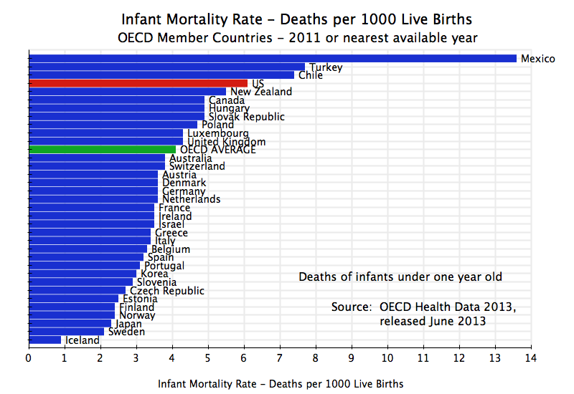
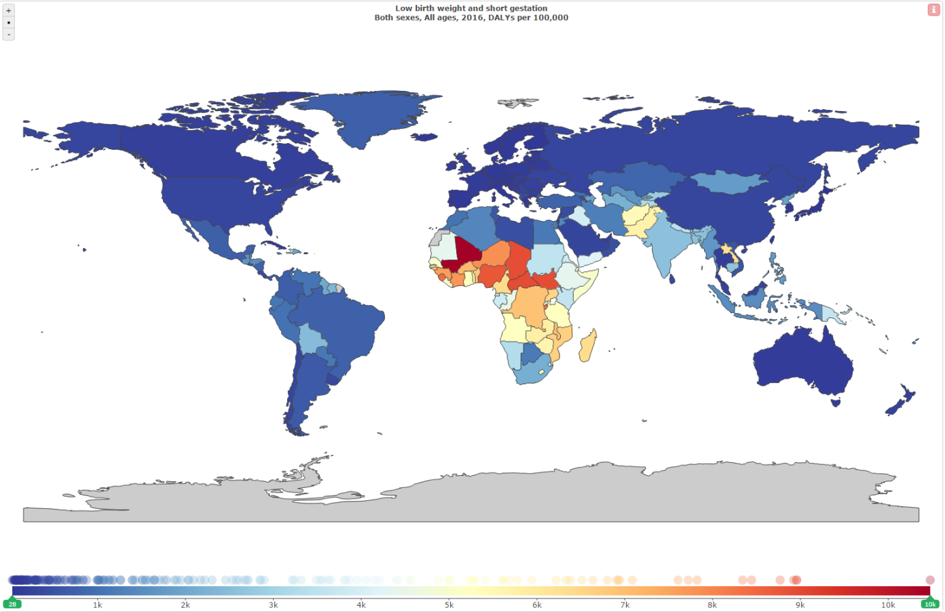
Disability due to low birth weight and short gestation (DALYs per 100,000)
Germany, 88
238
Japan, 28
Source: https://aneconomicsense.org/2013/11/22/us-health-care-high-cost-and-mediocre-results/
Global Burden of Disease, 2016. Map constructed using GBD Compare Viz Hub. https://vizhub.healthdata.org/gbd-compare/
Infant mortality rate in the U.S. is higher than
the average for other higher-income countries

Slide 3
Similar to national rates, the fertility rate* in the Bronx has declined modestly by 6%
In the Bronx, 25-29 year olds have the highest birth rate
*The fertility rate is the number of births over the number of women 15-44 years of age.
Data source: CDC Wonder Linked Birth/Infant Death Records, 2003-2015.

Slide 4
Teen (age 15-19y) birth rate

Slide 5
Bronx has the highest teen birth rate in New York City
Data source: CDC Wonder Births Data and Bridged-Race Population Estimates, 2015.

Slide 6
Teen birth rate in Bronx has declined by 50% since 2003, but is still 75% higher than the rest of NYC
Data source: CDC Wonder Births Data and Bridged-Race Population Estimates, 2003-2015.

Slide 7
Teen birth rates have declined in all racial/ethnic groups but the disparities remain constant
Data source: CDC Wonder Births Data and Bridged-Race Population Estimates, 2007-2015.

Slide 8
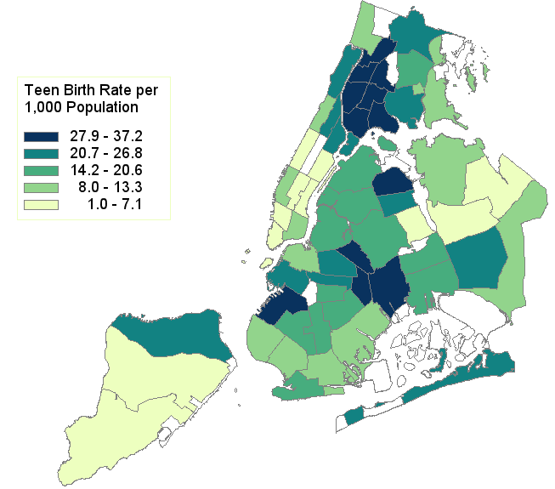
In the Bronx, Morrisania has the highest teen birth rate
8
12
7
5
6
11
4
3
10
2
9
1
Community District
(CD number in parentheses)
Data source: NYC Vital Statistics, National Vital Statistics Reports (Births: Final Data, 2015).

Slide 9
Timely initiation of prenatal care Defined as starting prenatal care in 1st, 2nd or 3rd month of pregnancy

Slide 10
In the Bronx, 9.3% of women do not get prenatal care until the 3rd trimester if not at all, compared to 5.5% in the rest of NYC and 5.9% nationally
Rest of New York City
Bronx
United States
Data source: NYC Vital Statistics, National Vital Statistics Reports (Births: Final Data, 2015).

Slide 11
Bronx has a much lower percent of mothers getting their first prenatal care visit in the first trimester of pregnancy than other NYC boroughs
Data source: NYC Vital Statistics, National Vital Statistics Reports (Births: Final Data, 2015).

Slide 12
The proportion of women starting prenatal care in the first trimester has increased, though the disparity has between the Bronx and rest of NYC has marginally worsened
Data source: NYC Vital Statistics, National Vital Statistics Reports (Births: 2000-2015).

Slide 13
Teen women, non-Hispanic black women and those with less education are least likely to start prenatal care in the first trimester
Data source: CDC Wonder Linked Birth/Infant Death Records, 2011-2015.

Slide 14
Racial/ethnic disparities in the early initiation of prenatal care in the Bronx have largely persisted
Data source: NYC Vital Statistics, National Vital Statistics Reports (Births: 2000-2015).

Slide 15
In the rest of NYC, the percent of teen mother’s starting prenatal care in the first trimester has increased by 13% as compared to 6% in the Bronx
Data source: CDC Wonder Births Data, 2007-2015.

Slide 16
Low birth weight
Defined as <2,500 grams
Data are limited to single births because there is evidence that multiple births are more likely to result in low birth weight.
Source: Ventura SJ, Martin JA, Curtin SC, Mathews TJ. Report of final natality statistics, 1996. Hyattsville, Maryland: US Department for Health and Human Services, CDC, National Center for Health Statistics. Monthly vital statistics reports (vol 46, no. 11).

Slide 17
Percent of total births with low birth weight has decreased by 10% in the Bronx
Birth weight distribution in the Bronx, 2015
Data source: CDC Wonder Births Data, 2007-2015.
Data limited to single births.

Slide 18
In the Bronx, non-Hispanic blacks have the highest percent of total births with low birth weight
2015
Data source: CDC Wonder Births Data, 2007-2015.
Data limited to single births.

Slide 19
Teens (and older women) are more likely to have a low birth weight infant as are women with less education
Data source: CDC Wonder Births Data, 2011-2015.
Data limited to single births.

Slide 20
Preterm delivery
Defined as <37 weeks
Data are limited to single births because there is evidence that multiple pregnancies greatly increase the risk for preterm delivery.
Source: Kurdi AM, Mesleh, RA, Al-Hakeem MM, et al. Multiple pregnancy and preterm labor. Saudi Med J 2004;25:632-7.

Slide 21
Percent of total births delivered preterm has declined by 9% in the Bronx
Gestational age distribution in the Bronx, 2015
Preterm defined as giving birth <37 weeks based on obstetrician/clinical estimate of gestational age
Data source: CDC Wonder Births Data, 2007-2015.
Data limited to single births.

Slide 22
In the Bronx, non-Hispanic blacks have the highest percent of preterm births
Preterm defined as giving birth <37 weeks based on obstetrician/clinical estimate of gestational age
Data source: CDC Wonder Births Data, 2015.
Data limited to single births.

Slide 23
Teens (and older women), as well as those with less education tend to have a higher preterm birth percentage
Preterm defined as giving birth <37 weeks based on obstetrician/clinical estimate of gestational age
Data source: CDC Wonder Births Data, 2015.
Data limited to single births.

Slide 24
Infant mortality rate

Slide 25
Bronx has the highest burden of infant mortality, of which the leading cause is disorders related to preterm and low birth weight, followed by congenital problems
Numbers of deaths of children < 1 year old due to each cause are shown
Data source: CDC Wonder Linked Birth/Infant Death Records, 2015.

Slide 26
Infant mortality rate in the Bronx has declined by 33%, but remains higher than the infant mortality rate in the rest of NYC
Data source: CDC Wonder Linked Birth/Infant Death Records, 1995-2014.

Slide 27
In the Bronx, mothers younger than 20 years old, non-Hispanic black, and without a high school diploma have the highest infant mortality rates
Data source: CDC Wonder Linked Birth/Infant Death Records, 2011-2015.

Slide 28
In the Bronx, infant mortality rate has declined by 40% among non-Hispanic blacks and disparities have modestly declined but do remain
Data source: CDC Wonder Linked Birth/Infant Death Records, 1995-2015.

Slide 29
In the Bronx, twins have an increased risk of infant mortality, as do very low birth weight and very preterm infants
Limited to single births
Birth weight (g)
Gestational Age (weeks)
Data source: CDC Wonder Linked Birth/Infant Death Records, 2011-2014.

Slide 30
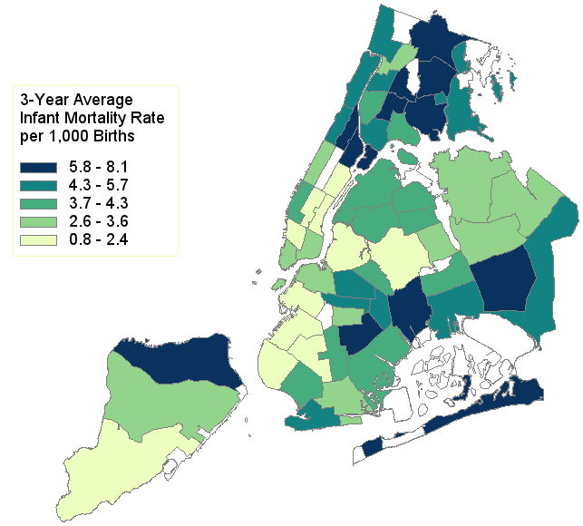
In the Bronx, Pelham Parkway has the highest infant mortality rate
8
12
7
5
11
6
4
3
10
9
1
2
Community District
(CD number in parentheses)
Data source: NYC Vital Statistics, 2013-2015.

Slide 31
Bronx has the second highest infant mortality rate among teen mothers
Data source: CDC Wonder Linked Birth/Infant Death Records, 2010-2015.
* Interpret with caution due to small numbers.

Slide 32
Maternal mortality rate from pregnancy or delivery complications

Slide 33
Maternal mortality rate from pregnancy or delivery complications has increased by 12% in the Bronx, but decreased by 31% in the rest of NYC
Data sources: CDC Wonder Underlying Cause of Death Data and Births Data, 2007-2015.

Slide 34
In the Bronx, 35+ year olds and non-Hispanic blacks have the highest mortality rates from pregnancy or delivery complications
Data sources: CDC Wonder Underlying Cause of Death Data and Births Data, 2007-2015.
# of deaths for non-Hispanic whites are not statistically reliable.

Slide 35
Pre-pregnancy BMI

Slide 36
The Bronx has the highest percent of women who are obese prior to pregnancy and this percentage has increased since 2008
2015
Data source: New York City Vital Statistics Birth Data, 2008-2015.

Slide 37
Diabetes during pregnancy

Slide 38
In both the Bronx and the rest of NYC the prevalence of diabetes during pregnancy has increased substantially
Defined as gestational diabetes + established diabetes
Data source: CDC Wonder Births Data, 2007-2015.

Slide 39
Diabetes during pregnancy is most common among older moms and those with less education
Defined as gestational diabetes + established diabetes
Age-adjusted
Data source: CDC Wonder Births Data, 2013-2015.

Slide 40
Chronic hypertension

Slide 41
Chronic hypertension during pregnancy is 2.5-times higher among women in the Bronx as compared to the rest of NYC
Data source: CDC Wonder Births Data, 2007-2015.

Slide 42
Among Bronx women, chronic hypertension during pregnancy is much more common among non-Hispanic black women and older women
Data source: CDC Wonder Births Data, 2013-2015.

Slide 43
Intent to exclusively breastfeed

Slide 44
The Bronx has the lowest percentage of women saying they plan to breastfeed exclusively & the disparity with the rest of NYC has widened
Data source: New York City Vital Statistics Birth Data, 2008-2015.

Slide 45
About the Community Health Dashboard Project
The goal of the project is to provide Bronx-specific data on risk factors and health outcomes with an emphasis on presenting data on trends, socio-demographic differences (e.g., by age, sex, race/ethnicity, etc.) and sub-county/neighborhood level data
Data will be periodically updated as new data becomes available.
Produced by Montefiore’s Office of Community & Population Health using publicly-available data sources
For more information please contact Colin Rehm, PhD, Manager of Research & Evaluation (crehm@montefiore.org).

