Slide 1
Bronx Community Health Dashboard: Influenza (Flu) Last Updated: 1/24/2018 See last slide for more information about this project.

Slide 2
Flu/pneumonia is the 3rd leading cause of death in Bronx
Data source: New York City Mortality Data (EpiQuery), 2015.

Slide 3
Flu Vaccination

Slide 4
Bronx adults are more likely to report getting a flu vaccination in the prior year
Data source: New York City Community Health Survey, 2002-2016.

Slide 5
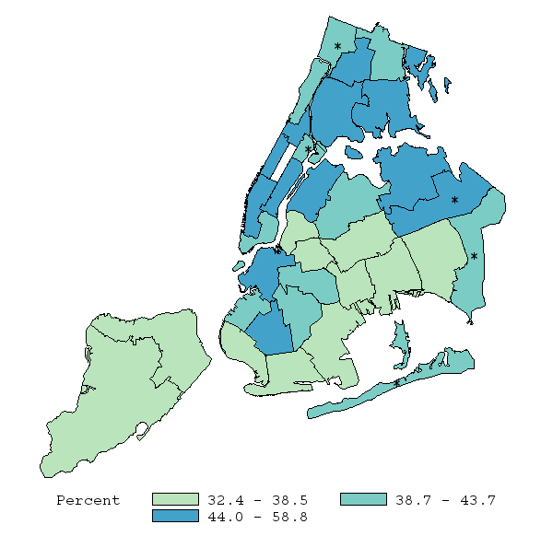
Bronx neighborhood with the highest flu vaccination rate is Kingsbridge
101
103
102
101 | Kingsbridge
102 | NE Bronx
103 | Fordham-Bronx Pk
104 | Pelham-Throgs Neck
105/106/107 | South Bronx
105
106
107
104
Data source: New York City Community Health Survey, 2016.

Slide 6
Bronx has the second highest flu vaccination rate. In the Bronx, older adults, females, and Hispanics have the highest flu vaccination rates
Bronx only
Data source: New York City Community Health Survey, 2016. Age specific rates not age-adjusted.

Slide 7
Flu vaccination coverage does not vary dramatically by education, though individuals with high (but not the highest) incomes are least likely to have been vaccinated
Data source: New York City Community Health Survey, 2016.

Slide 8
NYC adults with health insurance coverage have a higher flu vaccination rate
Data source: New York City Community Health Survey, 2016.

Slide 9
Emergency Department (ED) Visits for Influenza-Like Illness (ILI)
ILI is based on chief complaints made by the patient and is not based on laboratory diagnosis.
NYC Syndromic Surveillance System captures data on ED visits from all 53 EDs in NYC.

Slide 10
ED visits for ILI are highest in the Bronx
Data source: New York City Syndromic Surveillance Data, 10/01/2016-04/30/2017. Analysis by Montefiore OCPH.
2016 population estimates are from Census. Data are not age-adjusted.

Slide 11
ED visits for ILI has remained highest in the Bronx for the past 11 flu seasons
Data source: New York City Syndromic Surveillance Data, 10/01/2006-04/30/2017. Analysis by Montefiore OCPH.
2016 population estimates are from Census.

Slide 12
In the Bronx, ED visits for ILI are highest for children ages 0-4
Data source: New York City Syndromic Surveillance Data, 10/01/2016-04/30/2017. Analysis by Montefiore OCPH.
2016 population estimates are from Census.

Slide 13
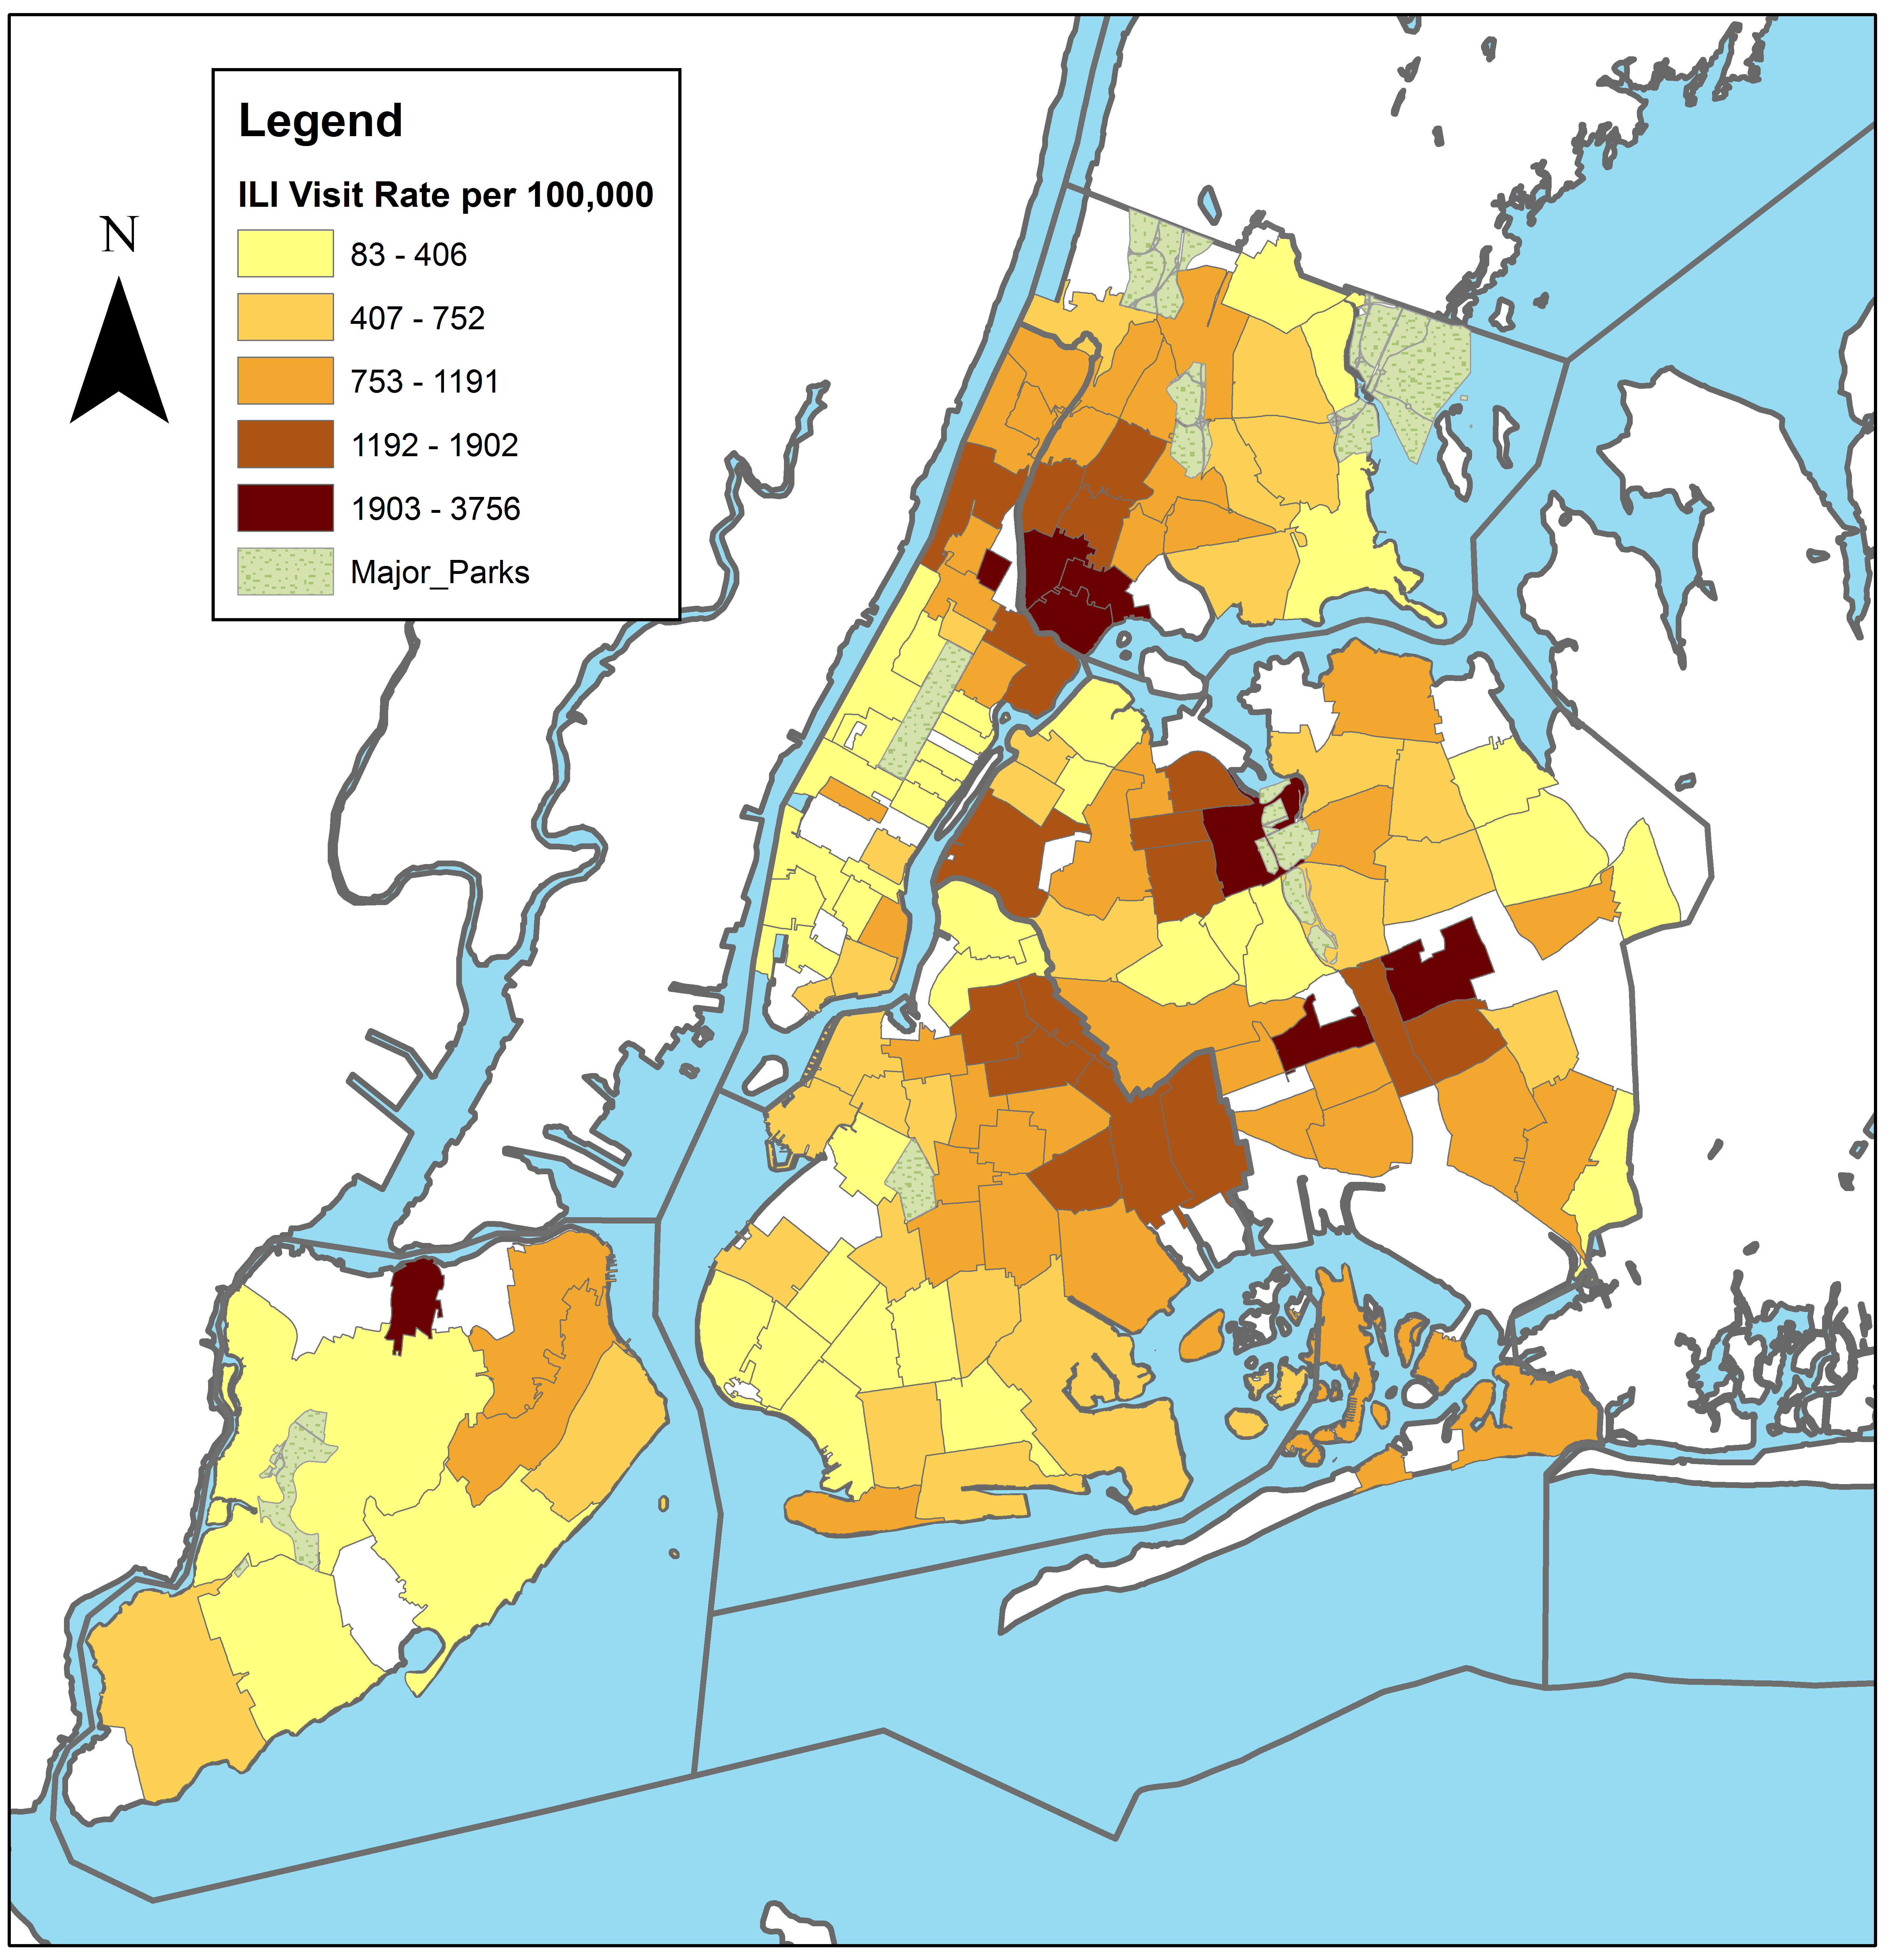
South Bronx has the highest ILI visit rate in NYC
Data source: New York City Syndromic Surveillance Data, 10/01/2016-04/30/2017. Analysis by Montefiore OCPH.
2016 population estimates are from Census. Blank ZIP Codes have no visits or too few visits to calculate reliable rate.

Slide 14
Laboratory-Confirmed Influenza

Slide 15
Since 2009 rates of laboratory confirmed influenza have consistently been higher in the Bronx as compared to the rest of NYC
Increase may pick up increased use of laboratory test and does not indicate that flu is more common. Data are best used to compare boroughs to each other.
Data source: New York City EpiQuery: Communicable Disease Surveillance Data, 2006-2016.

Slide 16
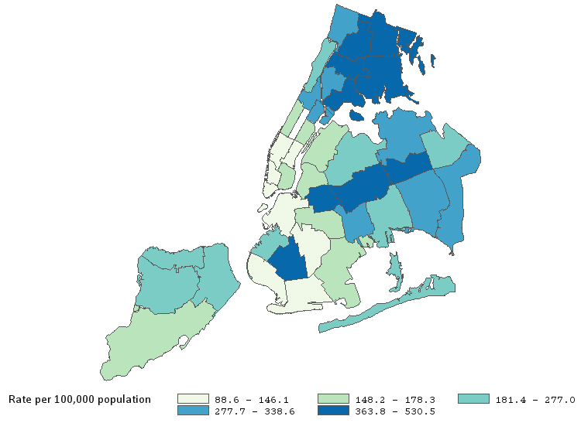
In the Bronx, the neighborhood with the highest rate of laboratory confirmed influenza is Northeast Bronx
101
103
102
105
104
106
107
Data source: New York City EpiQuery: Communicable Disease Surveillance Data, 2016.

Slide 17
Mortality from Influenza and Pneumonia

Slide 18
Generally, influenza/pneumonia mortality in the Bronx has been higher than the rest of NYC and the US overall
Data source: Underlying Cause of Death, 1999-2015.

Slide 19
Males have a higher mortality rate from influenza and pneumonia in the Bronx than females
Data source: Underlying Cause of Death, 1999-2015.

Slide 20
Within the Bronx, Hunts Point has the highest mortality rate from influenza and pneumonia
Data source: NYC Community District Data (EpiQuery), 2015.

Slide 21
About the Community Health Dashboard Project
The goal of the project is to provide Bronx-specific data on risk factors and health outcomes with an emphasis on presenting data on trends, socio-demographic differences (e.g., by age, sex, race/ethnicity, etc.) and sub-county/neighborhood level data
Data will be periodically updated as new data becomes available.
Produced by Montefiore’s Office of Community & Population Health using publicly-available data sources
For more information please contact Colin Rehm, PhD, Manager of Research & Evaluation (crehm@montefiore.org).

